Slide 1


Slide 2

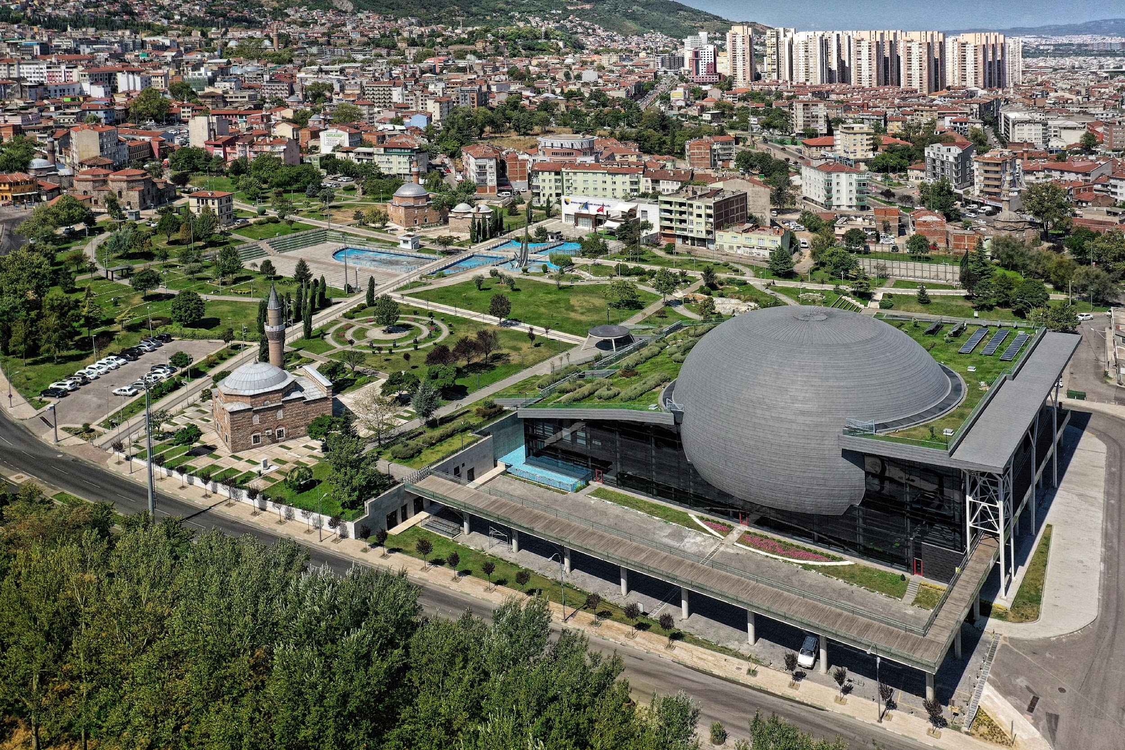
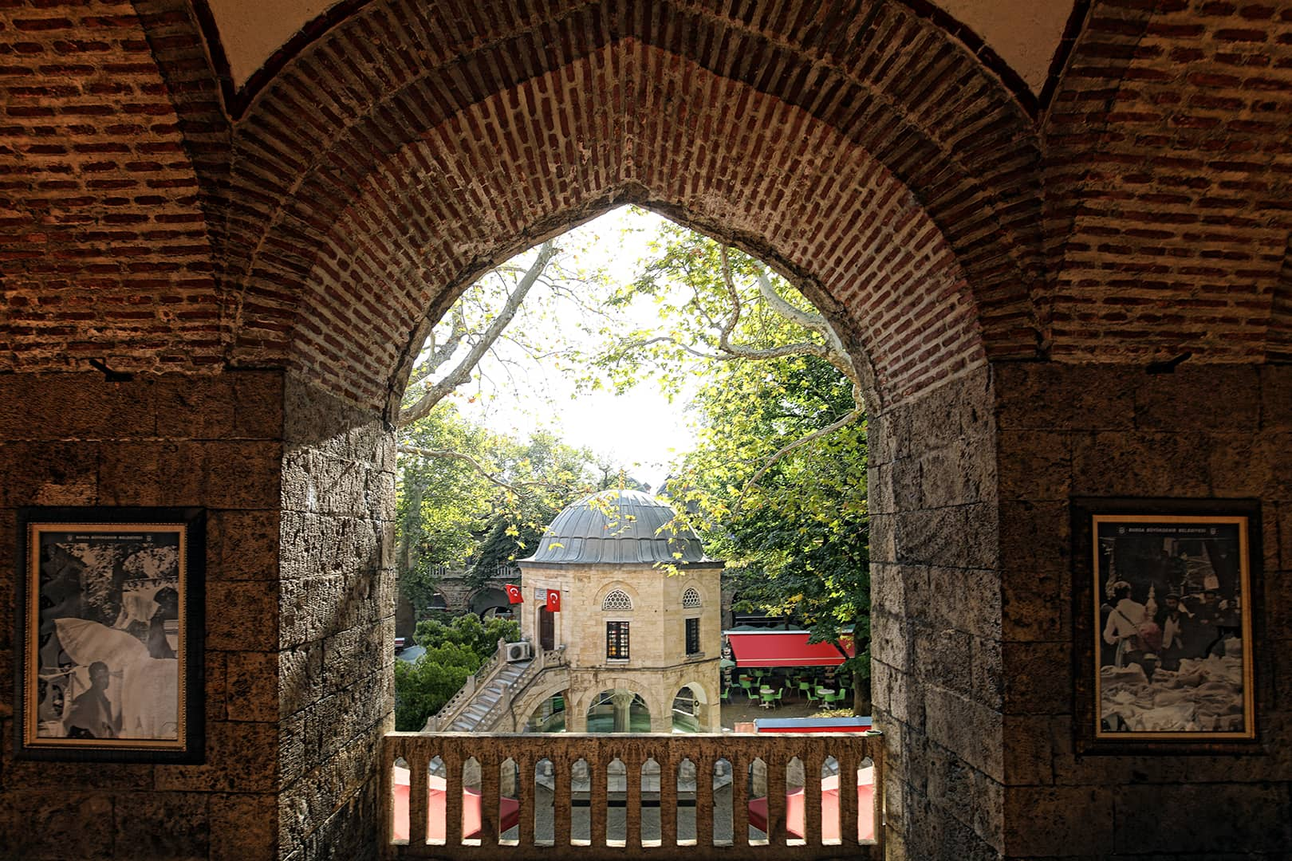
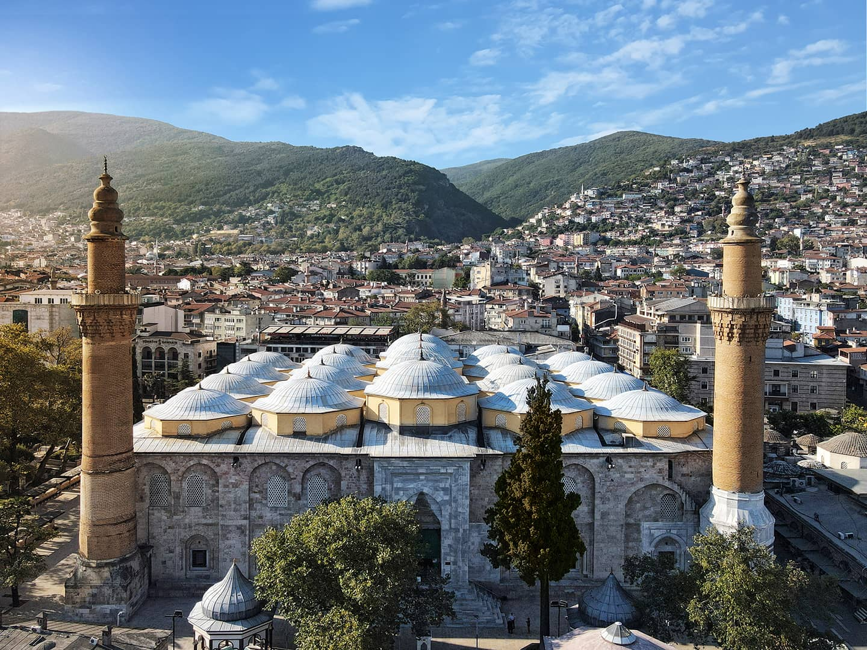
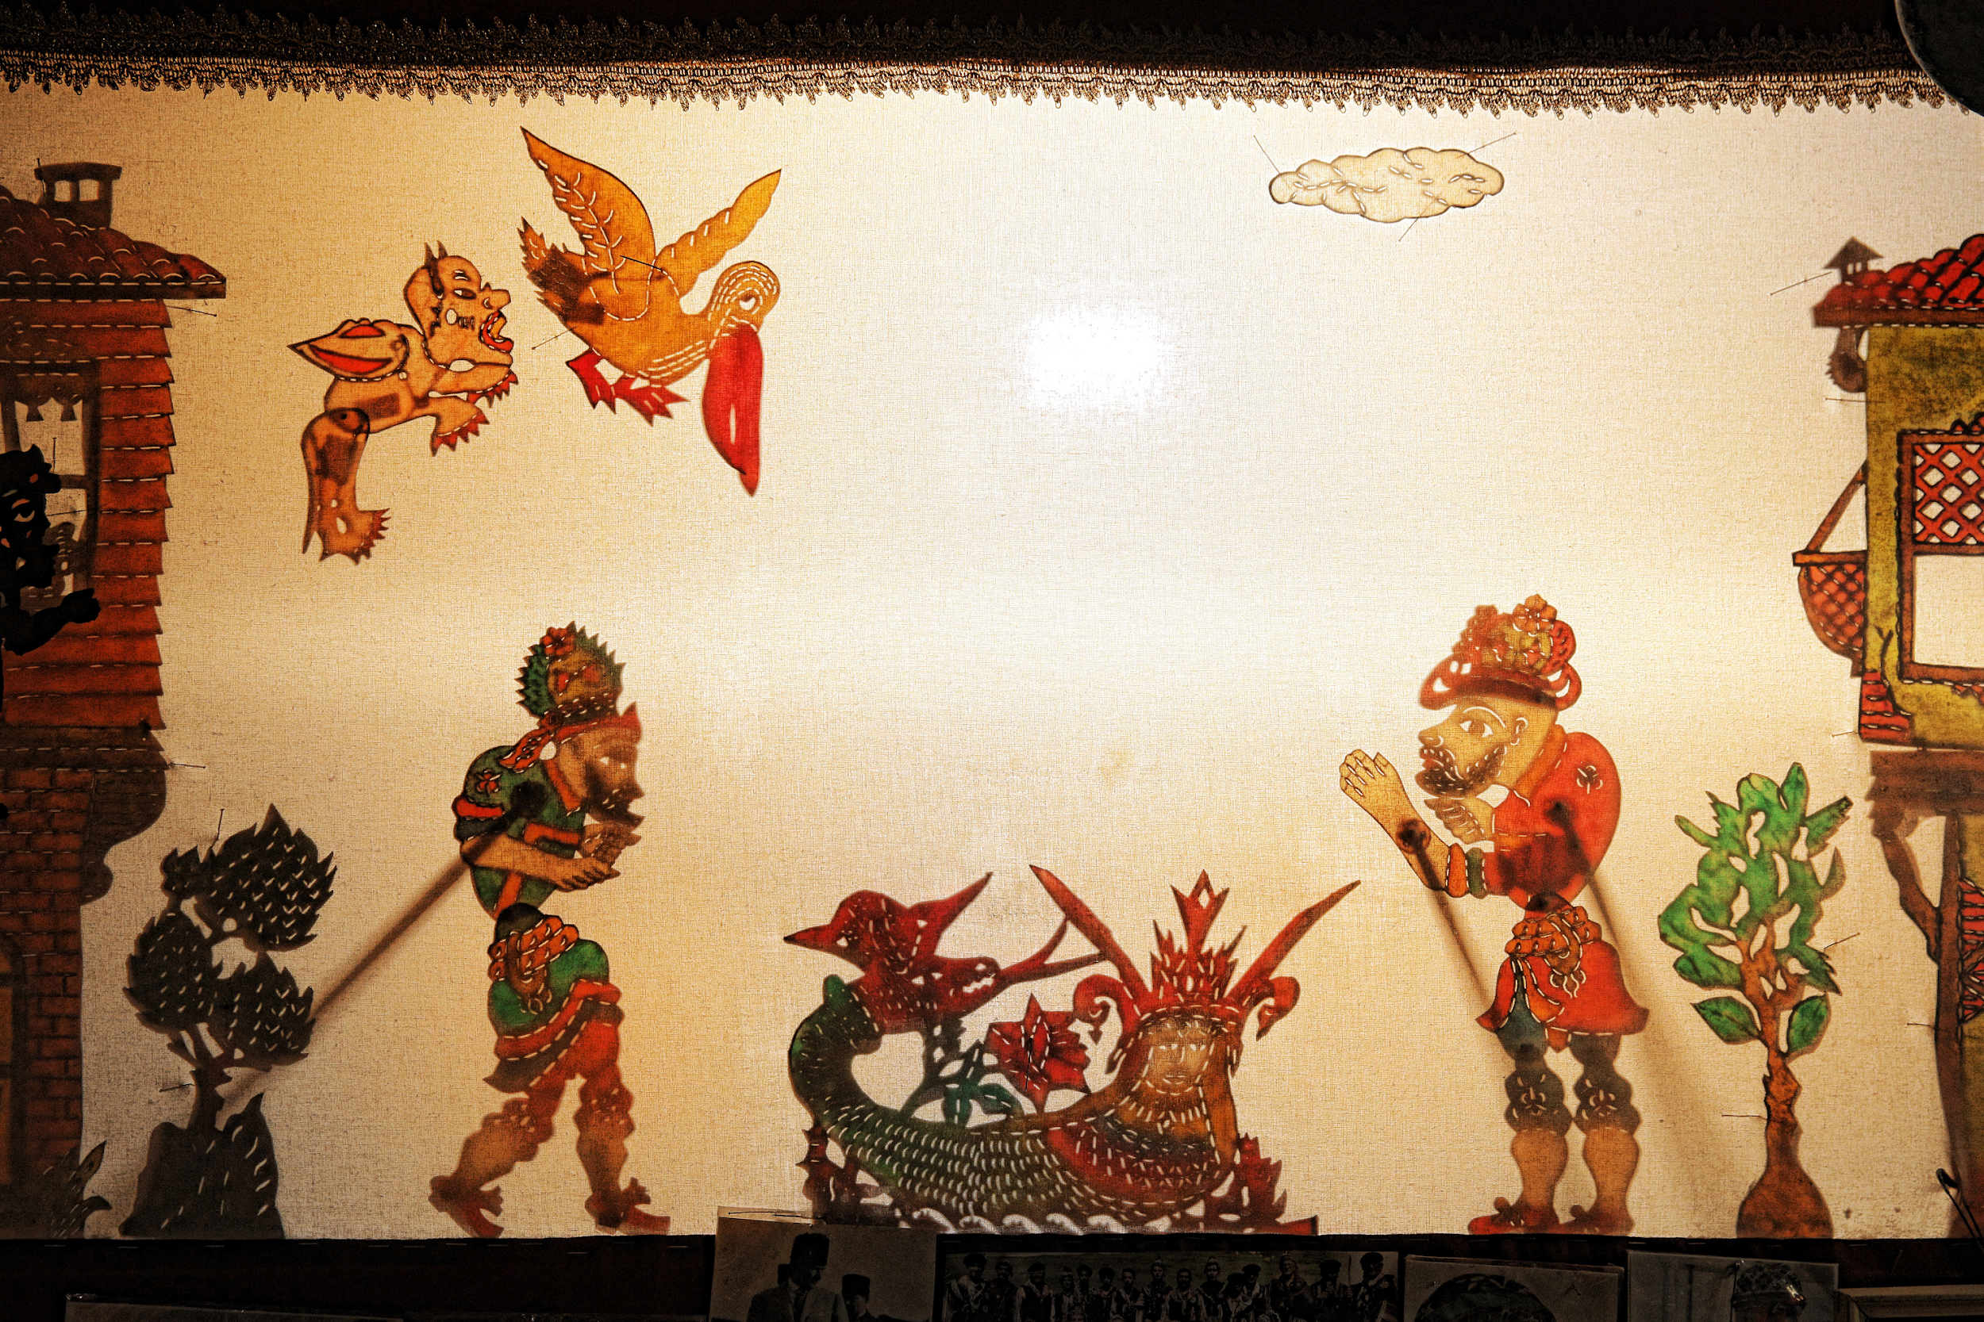
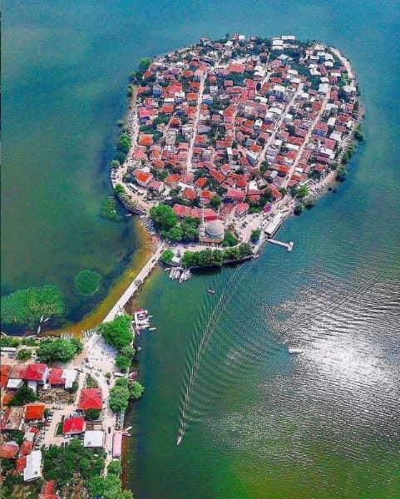
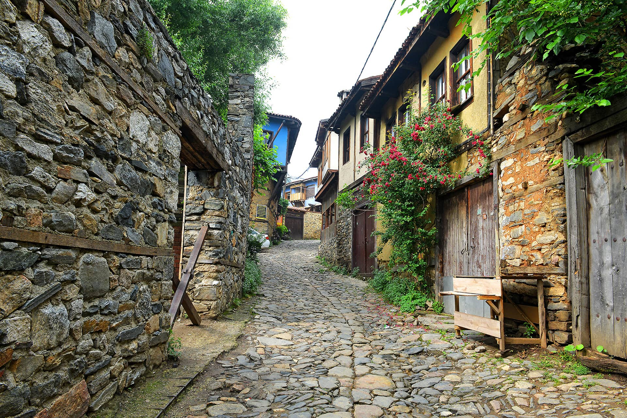
BURSA A Historical and Industrial Hub

Slide 3
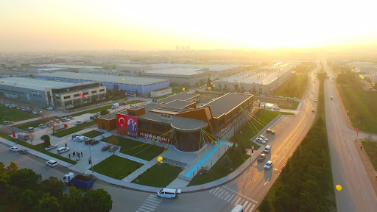
BURSA
A dynamic industrial & cultural hub.
Strong sectors: automotive, textiles, machinery, new tech.
Ideal environment for research & innovation.
BUU is fully integrated with the city’s ecosystem.
Vision: “University harmonized with the city.”
Joint R&D and technology‑transfer collaborations.
Applied training linked to industrial needs.
Innovation supported through ULUTEK Technopark.

Slide 4
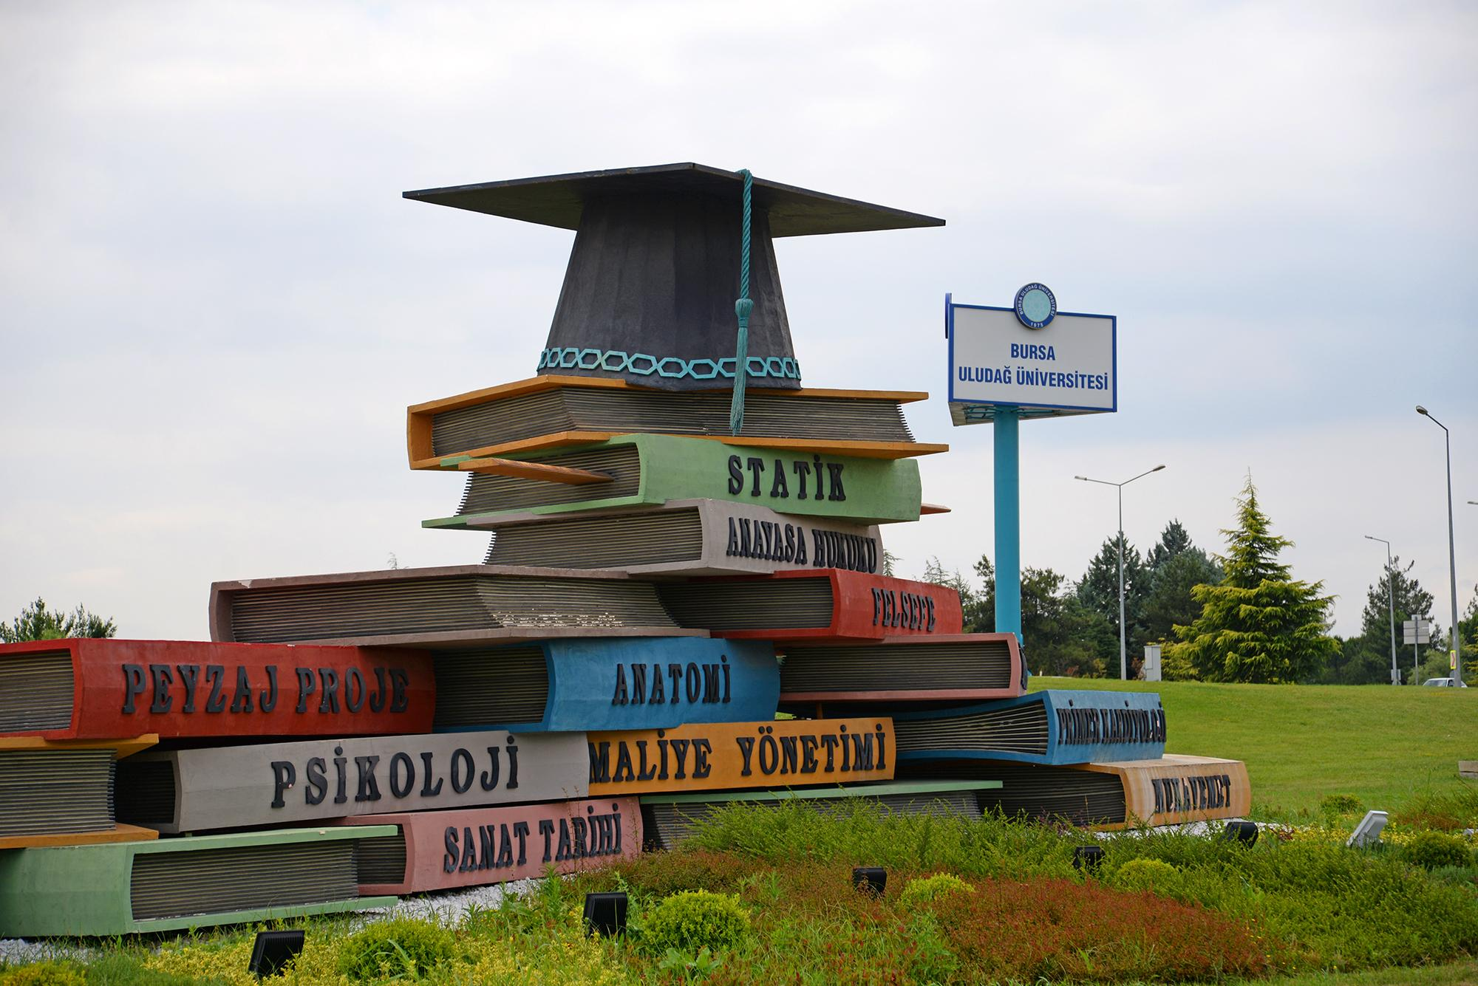
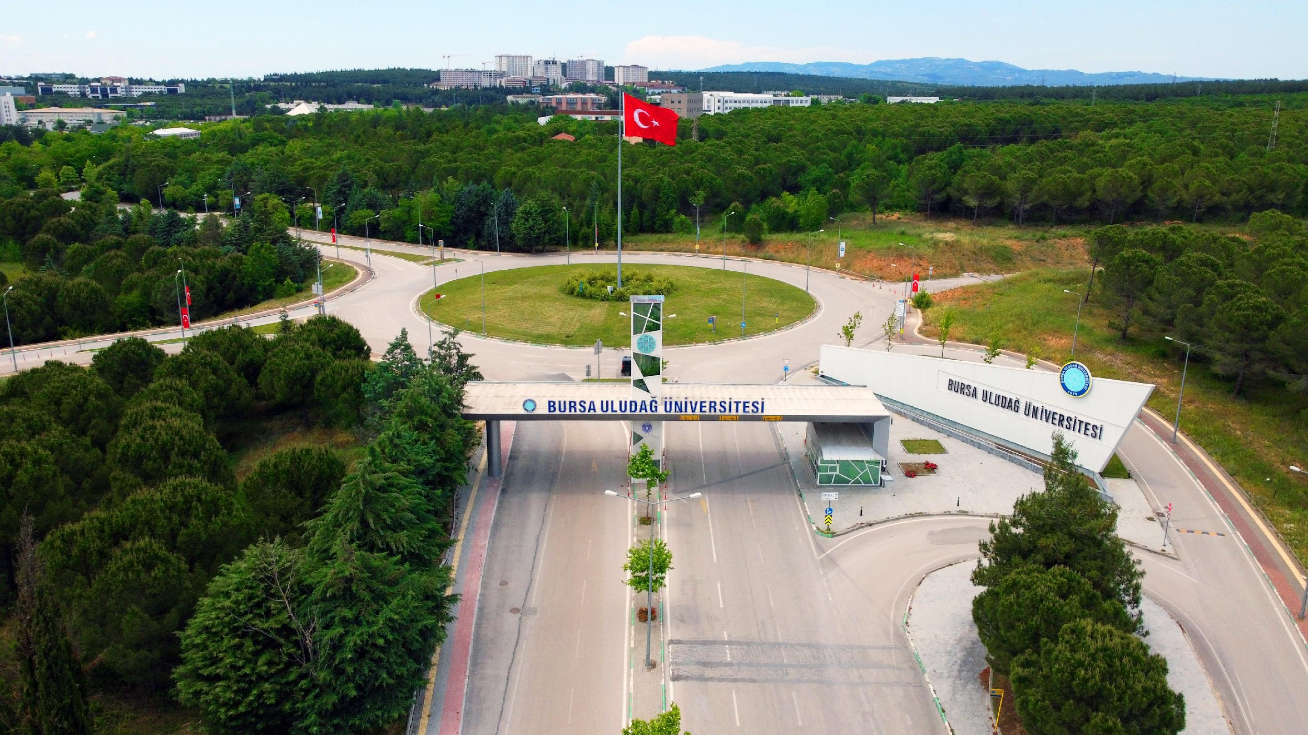
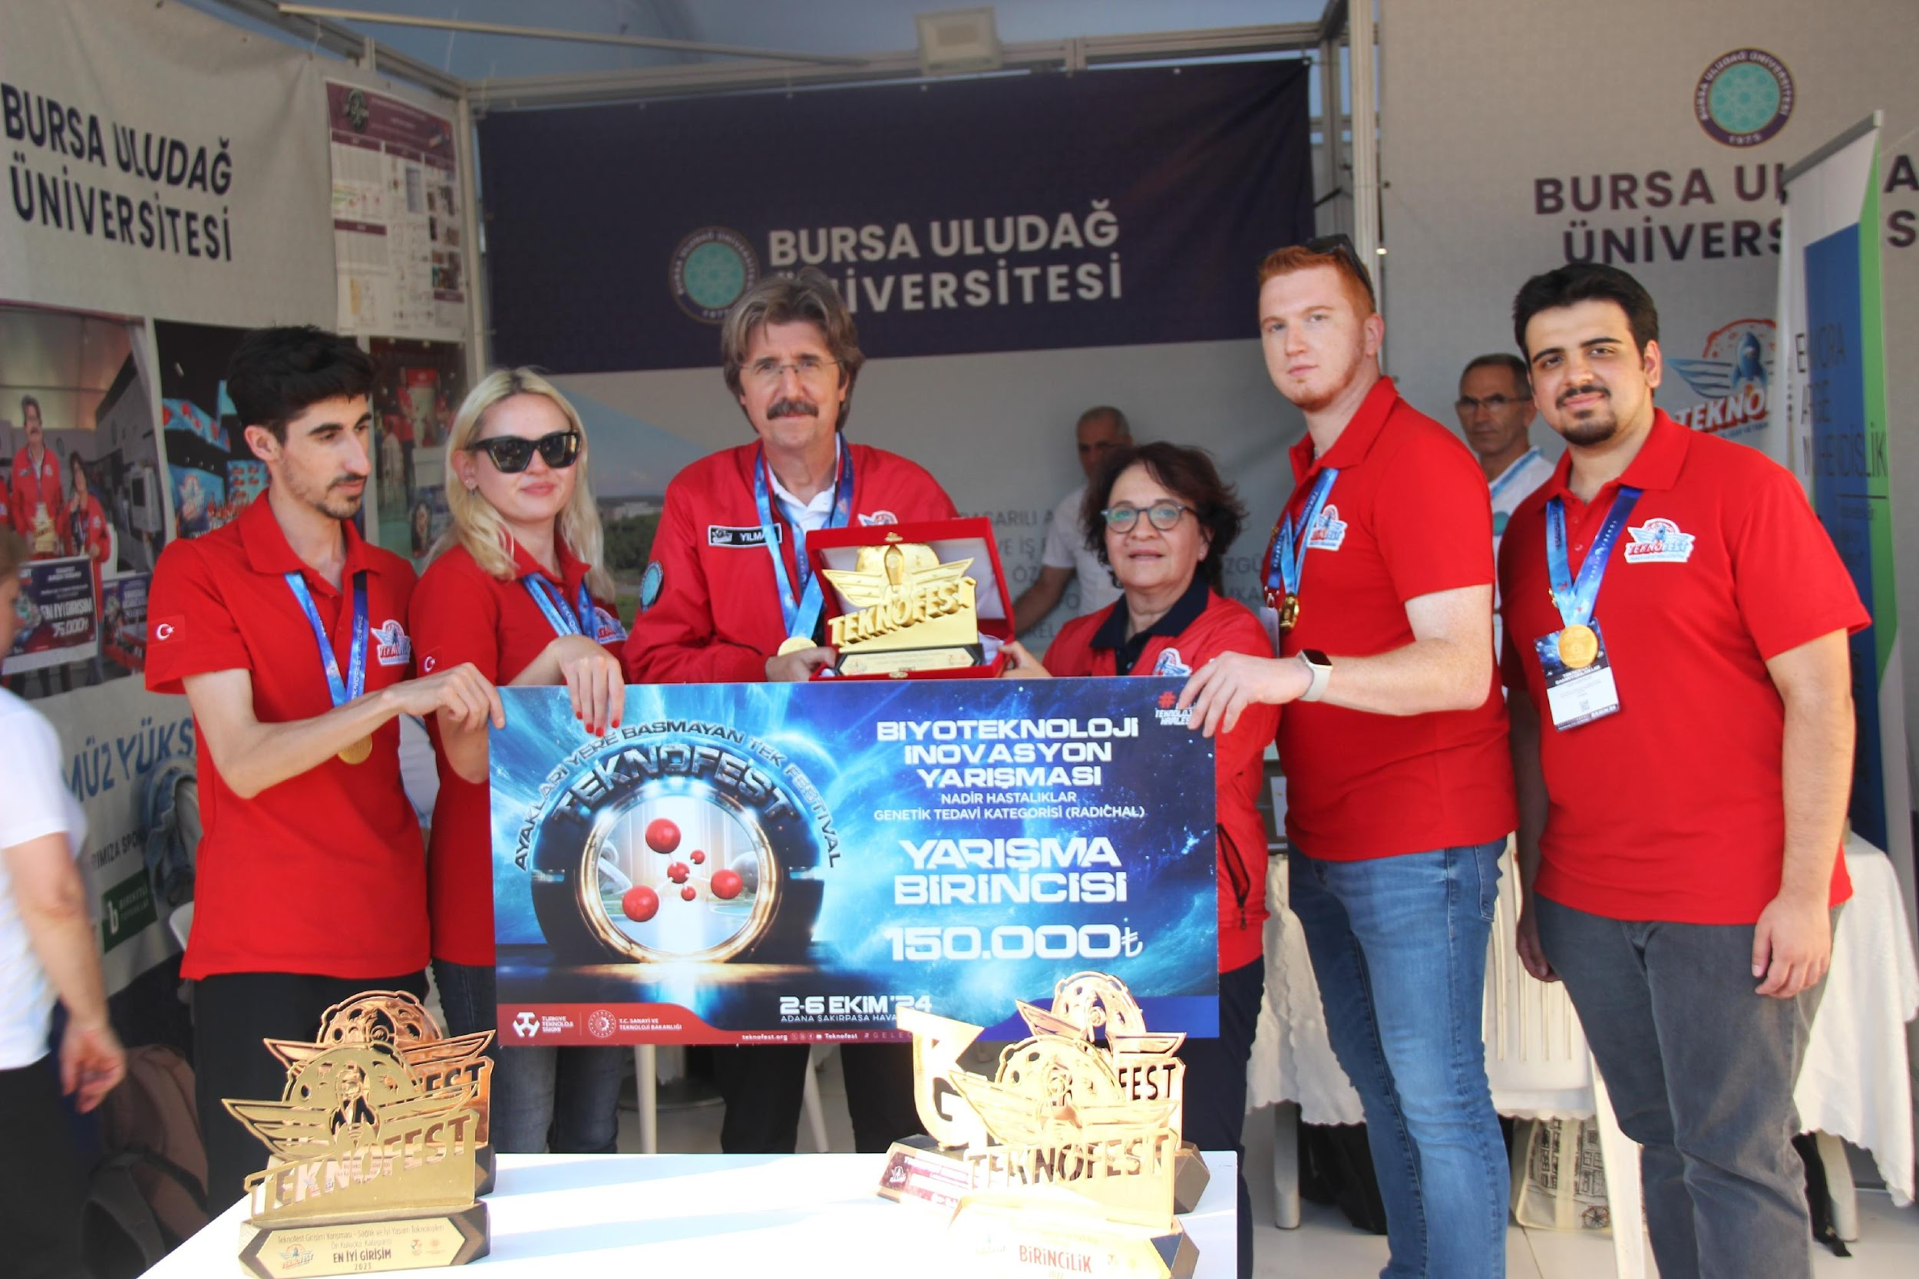
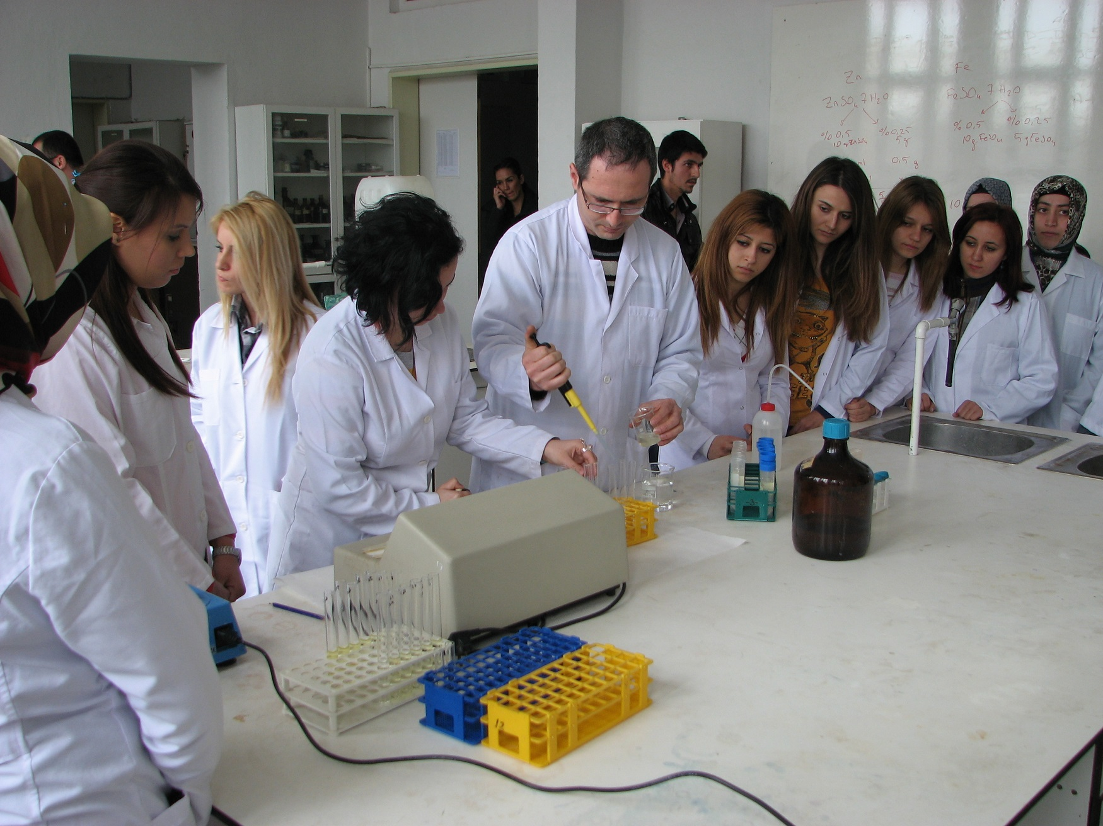
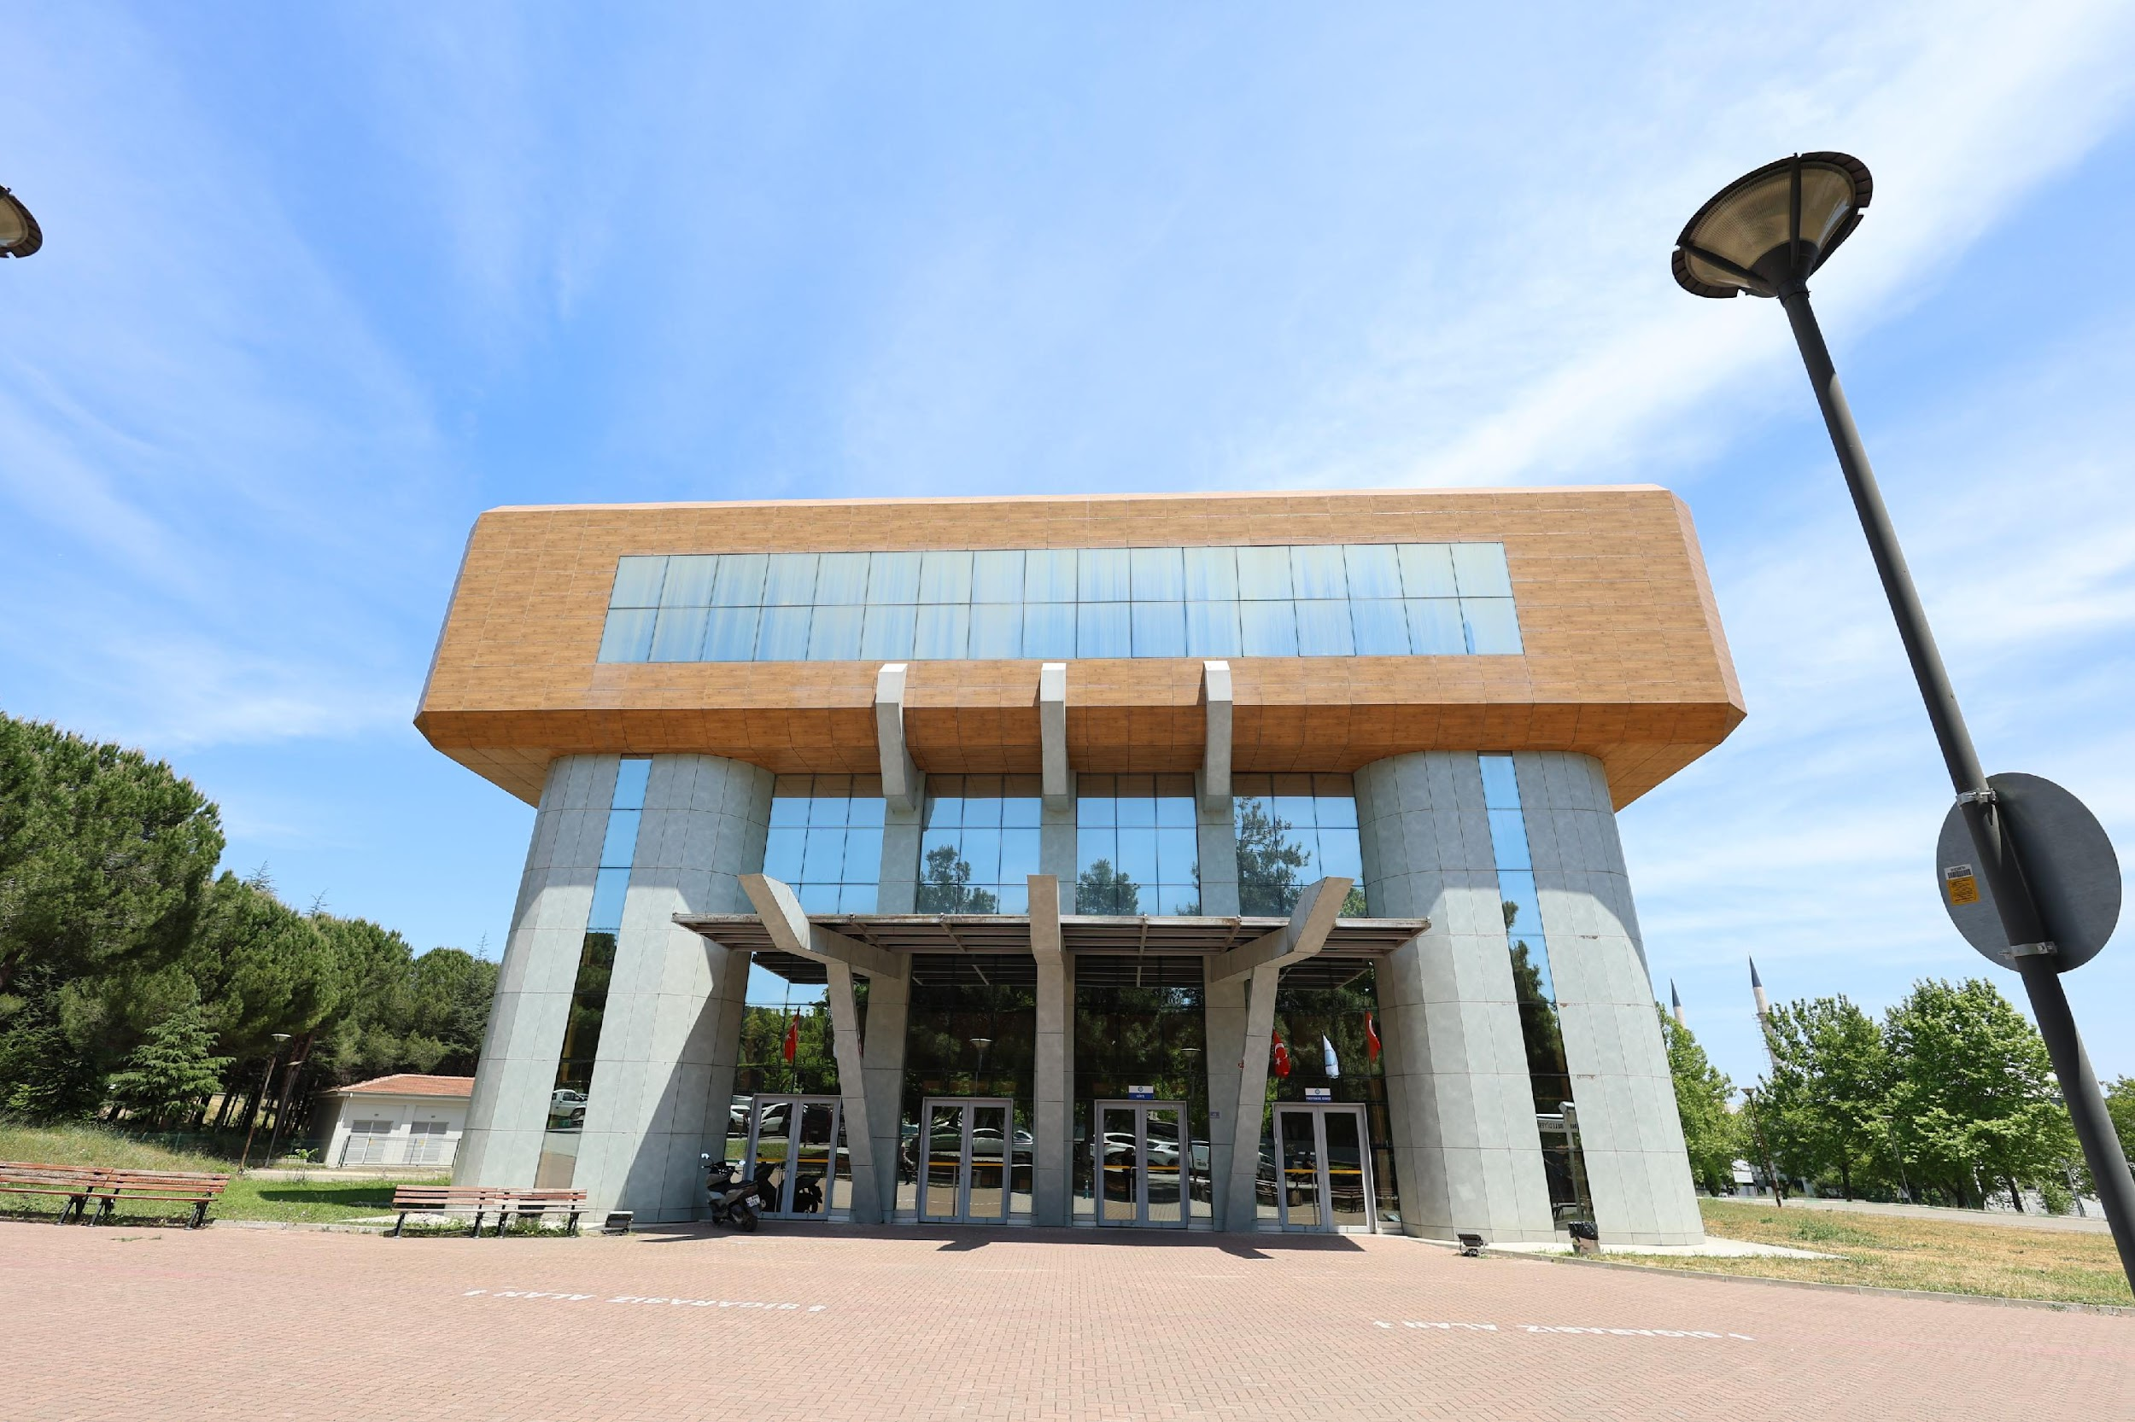
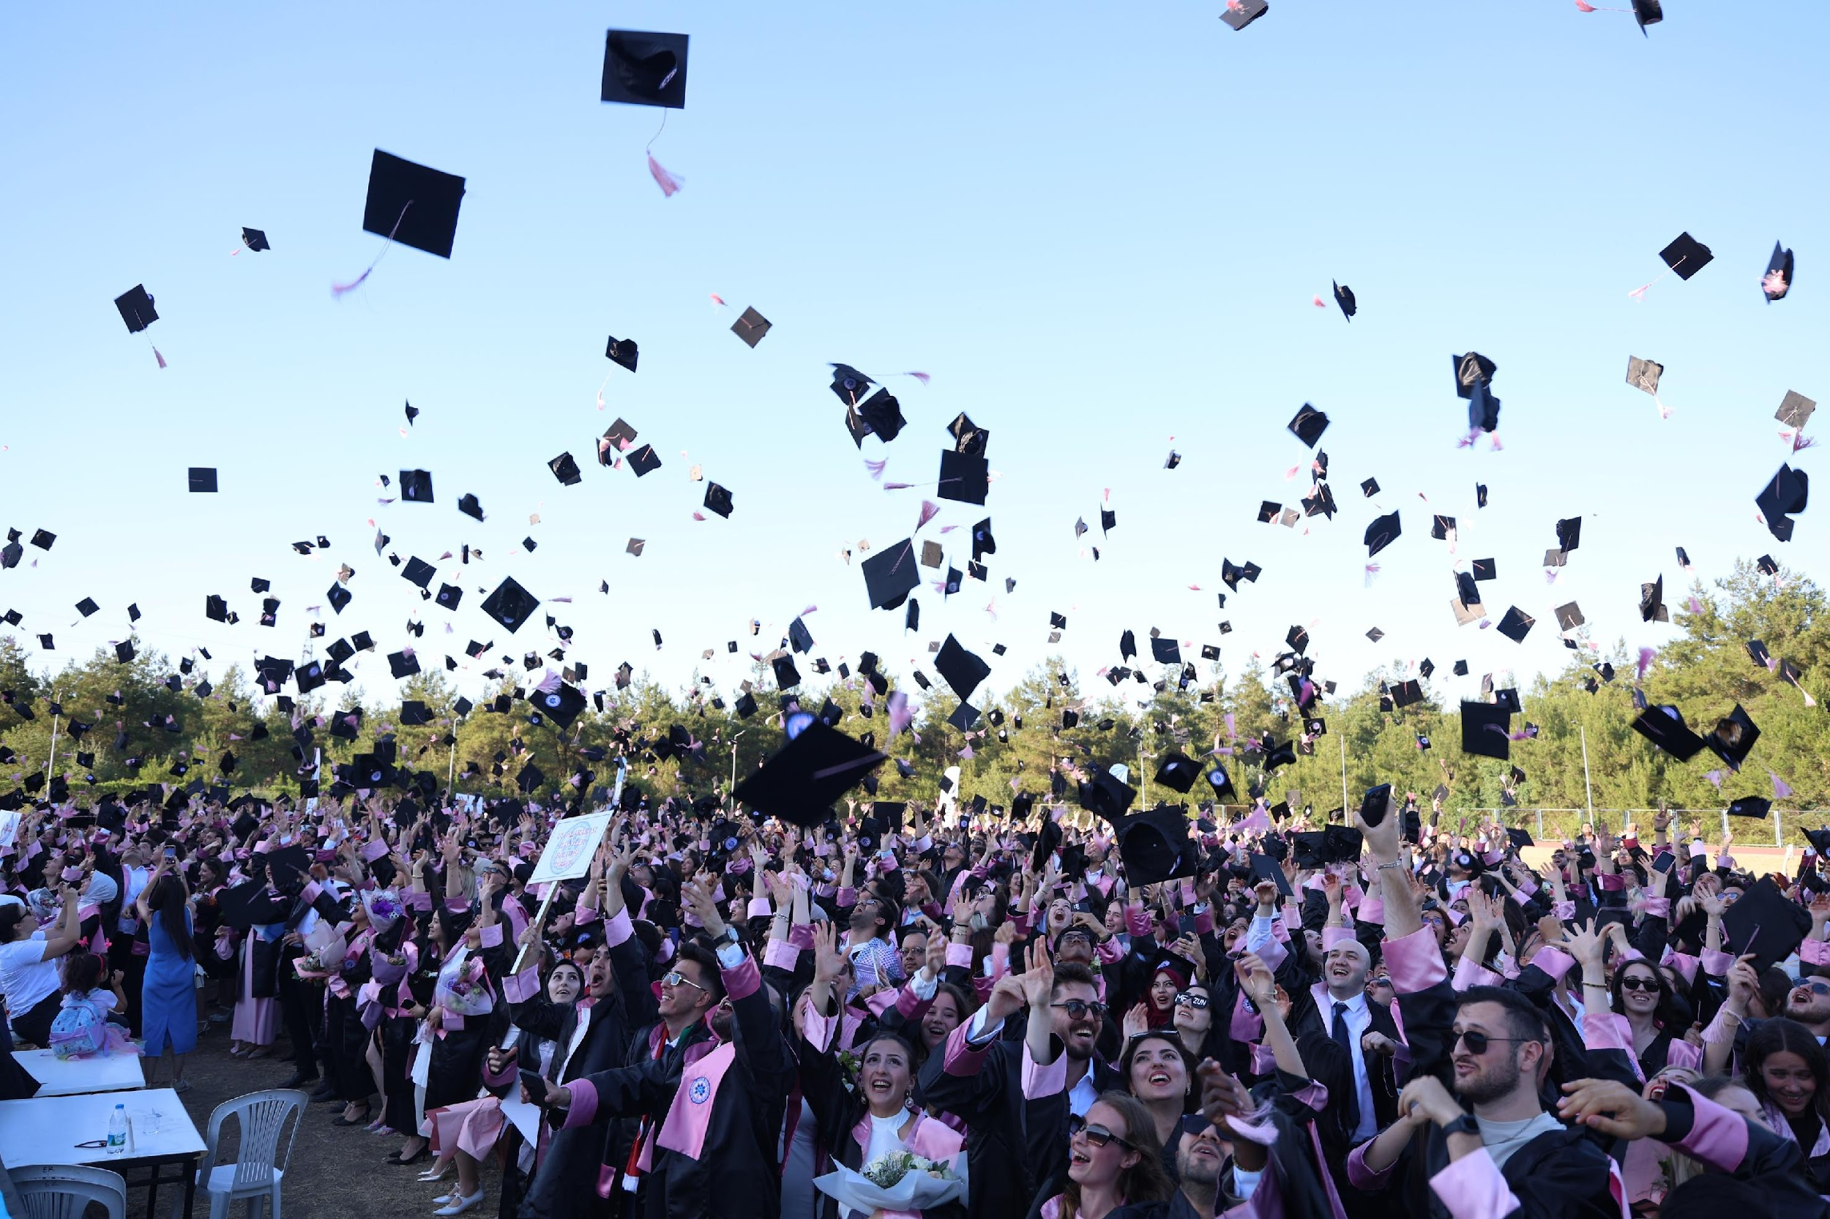
Bursa Uludağ University Overview

Slide 5
Historical Development
Established as the Bursa Faculty of Economics and Social Sciences under Istanbul University.
Established as the Bursa Faculty of Medicine under Istanbul University.
The university was renamed Uludağ University.
1970
1974
1982
1975
2018
Bursa University was established.
The university adopted its current name: Bursa Uludağ University.

Slide 6
BUU AT A GLANCE:
CORE STRENGTHS
Historical Development
BUU evolved from its origins in 1970, proudly marked the 50th year in 2025, proving to be a mature higher education institution.
Academic and Research Excellence
BUU hosts over 56,000 students and 2,900 academic staff supported by advanced facilities and extensive research centers.
Strategic Location and Accessibility
Located in Bursa, Türkiye’s fourth largest city, BUU benefits from rich culture and strong industry cooperation.
Global Orientation and Student Focus
BUU emphasizes internationalization and nurturing graduates with skills for the global marketplace.
A Research University Where Heritage Meets Industry and Innovation

Slide 7
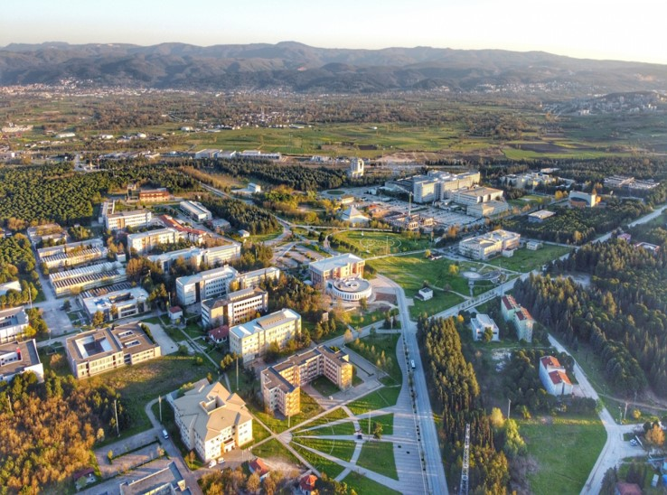
Facts and Figures
CATEGORY | VALUE
Students | 56,958
Academic Staff | 2,901
Administrative Staff | 4,173
Faculties | 15 (233 programmes)
Vocational Schools | 15 (171 programmes)
Research Centers | 27

Slide 8
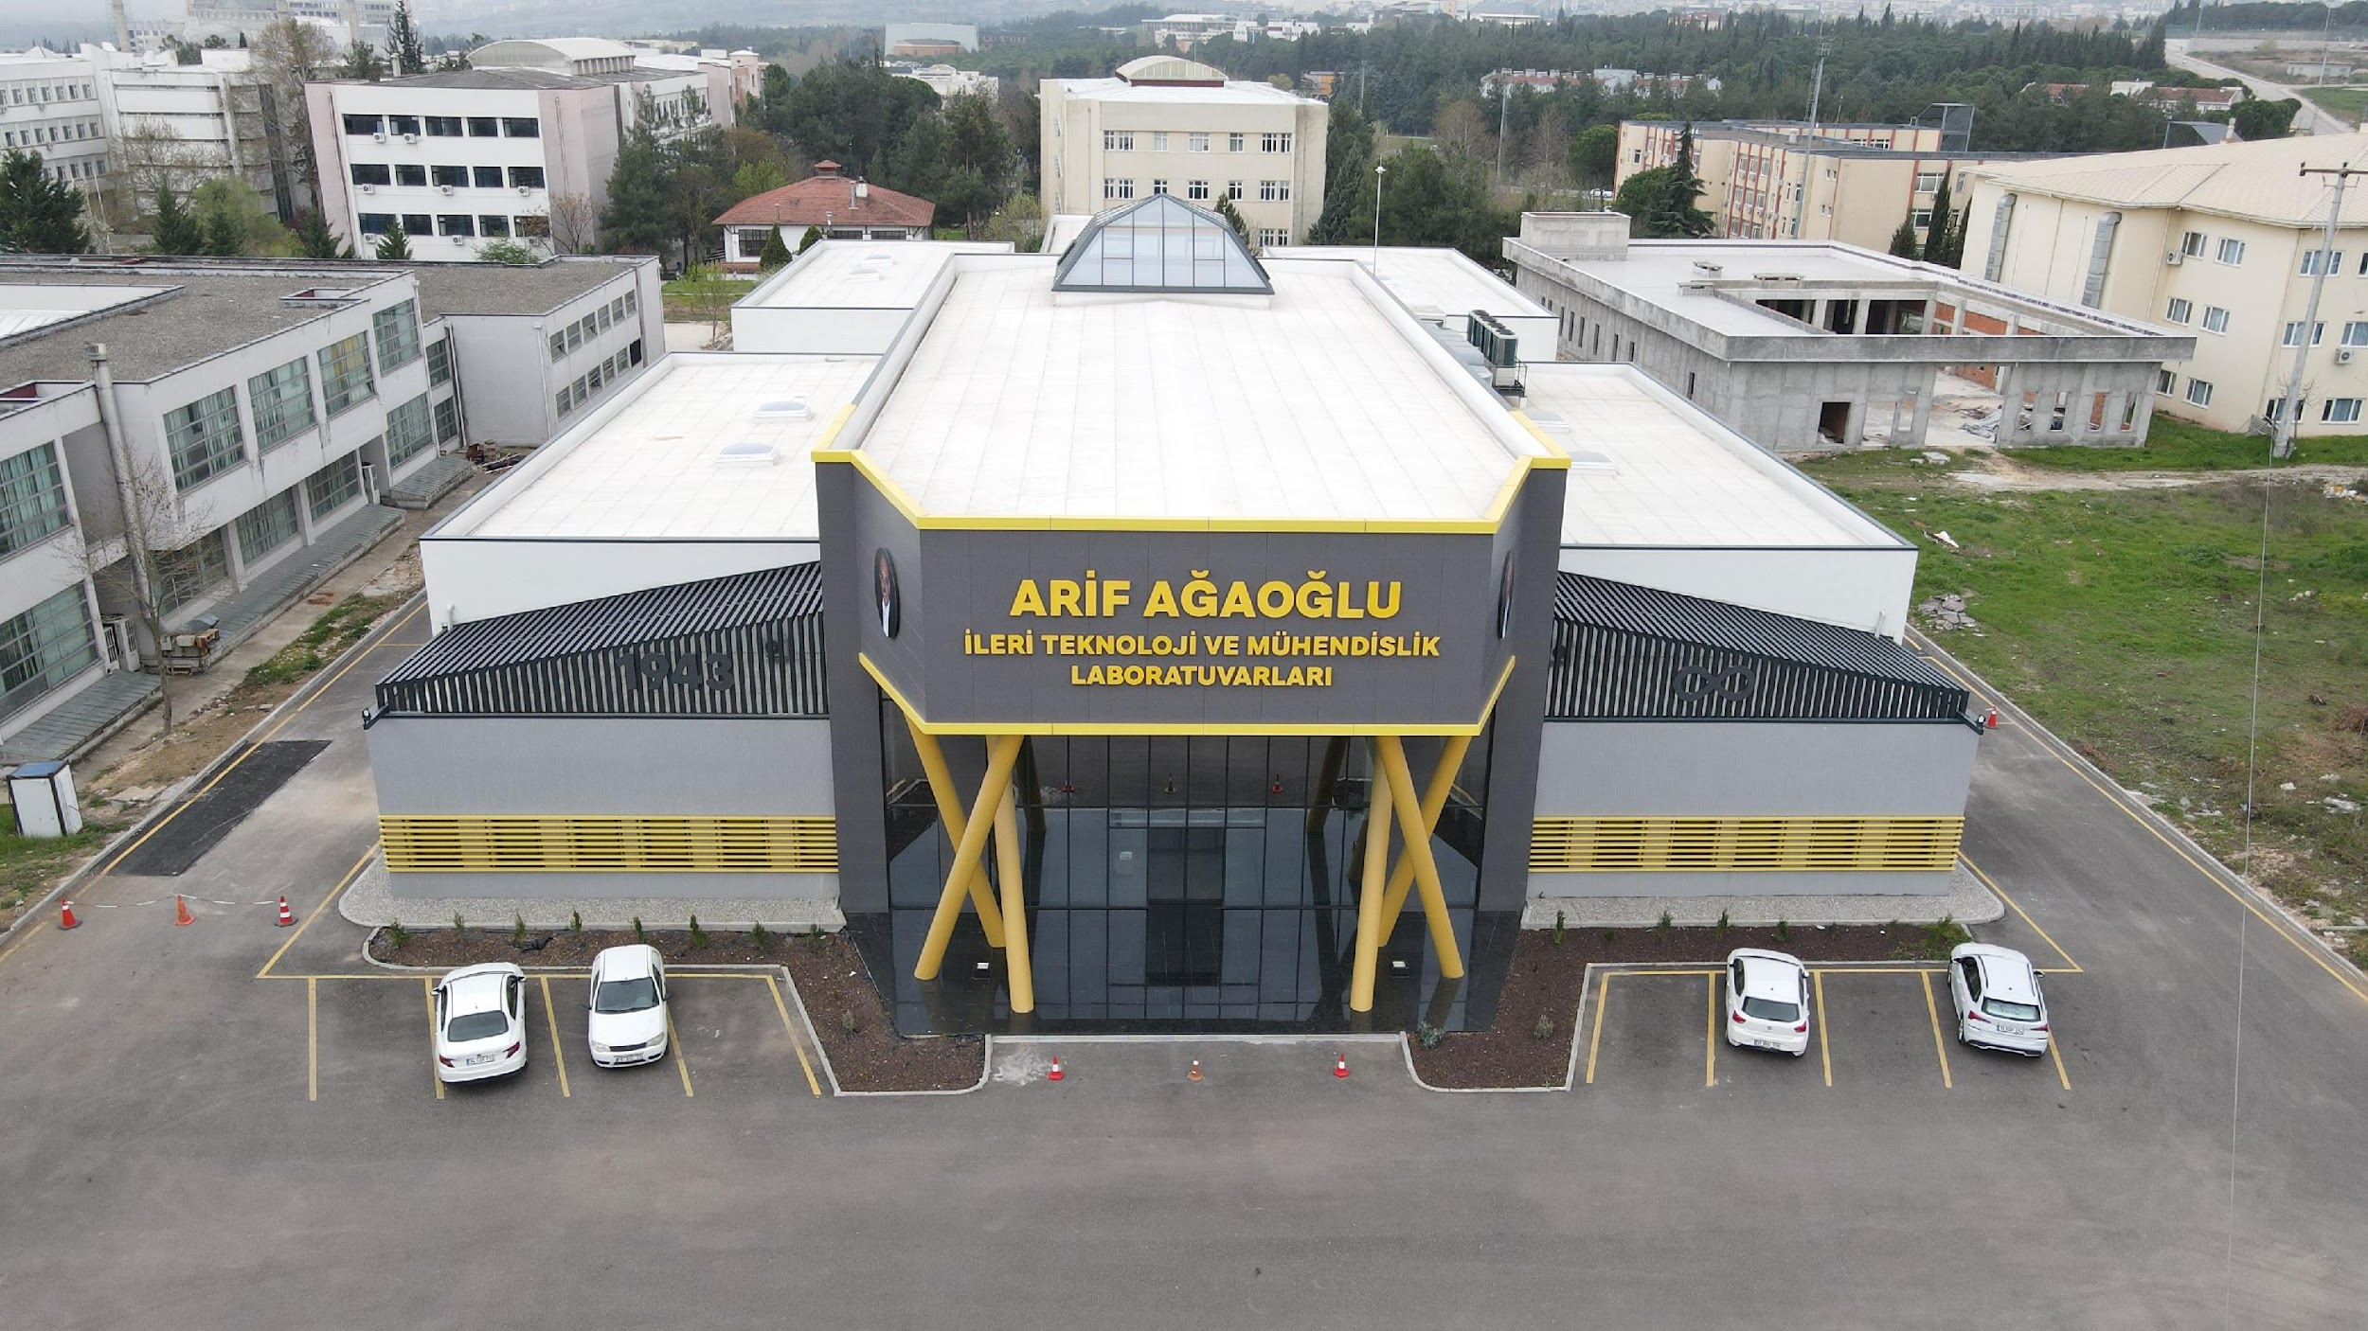
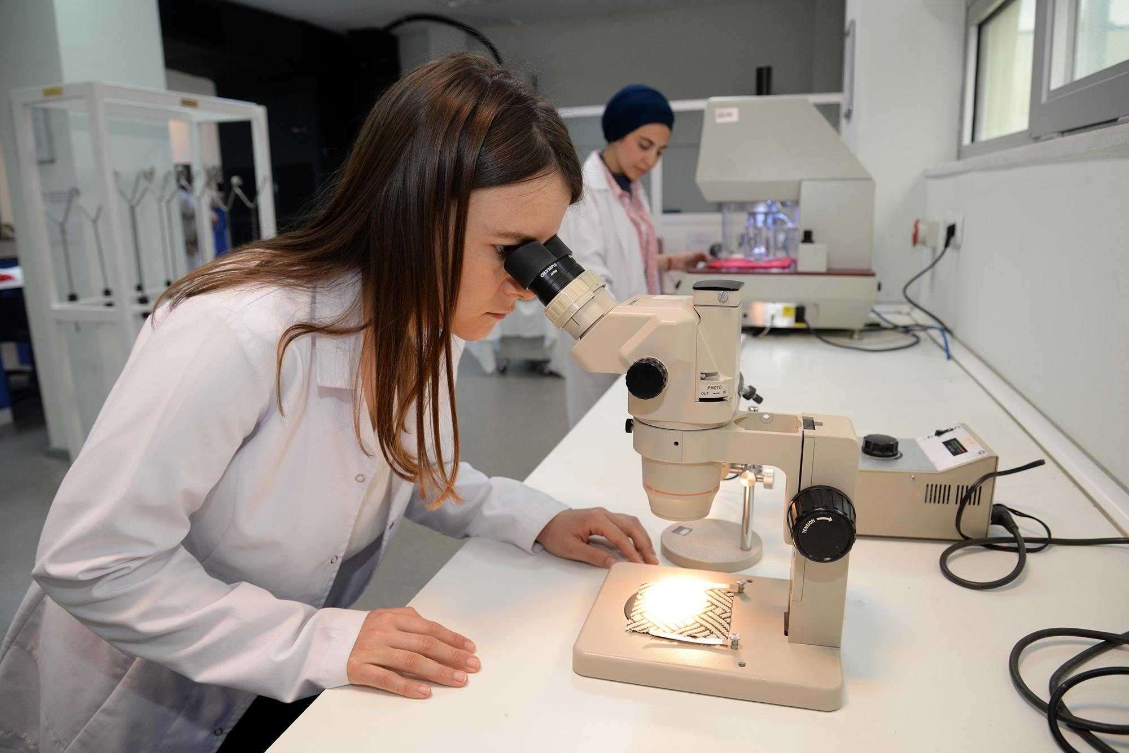
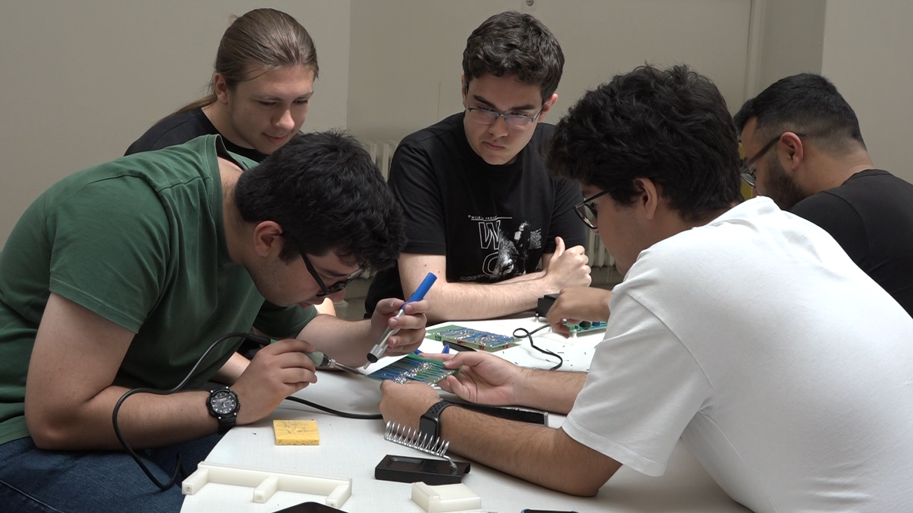
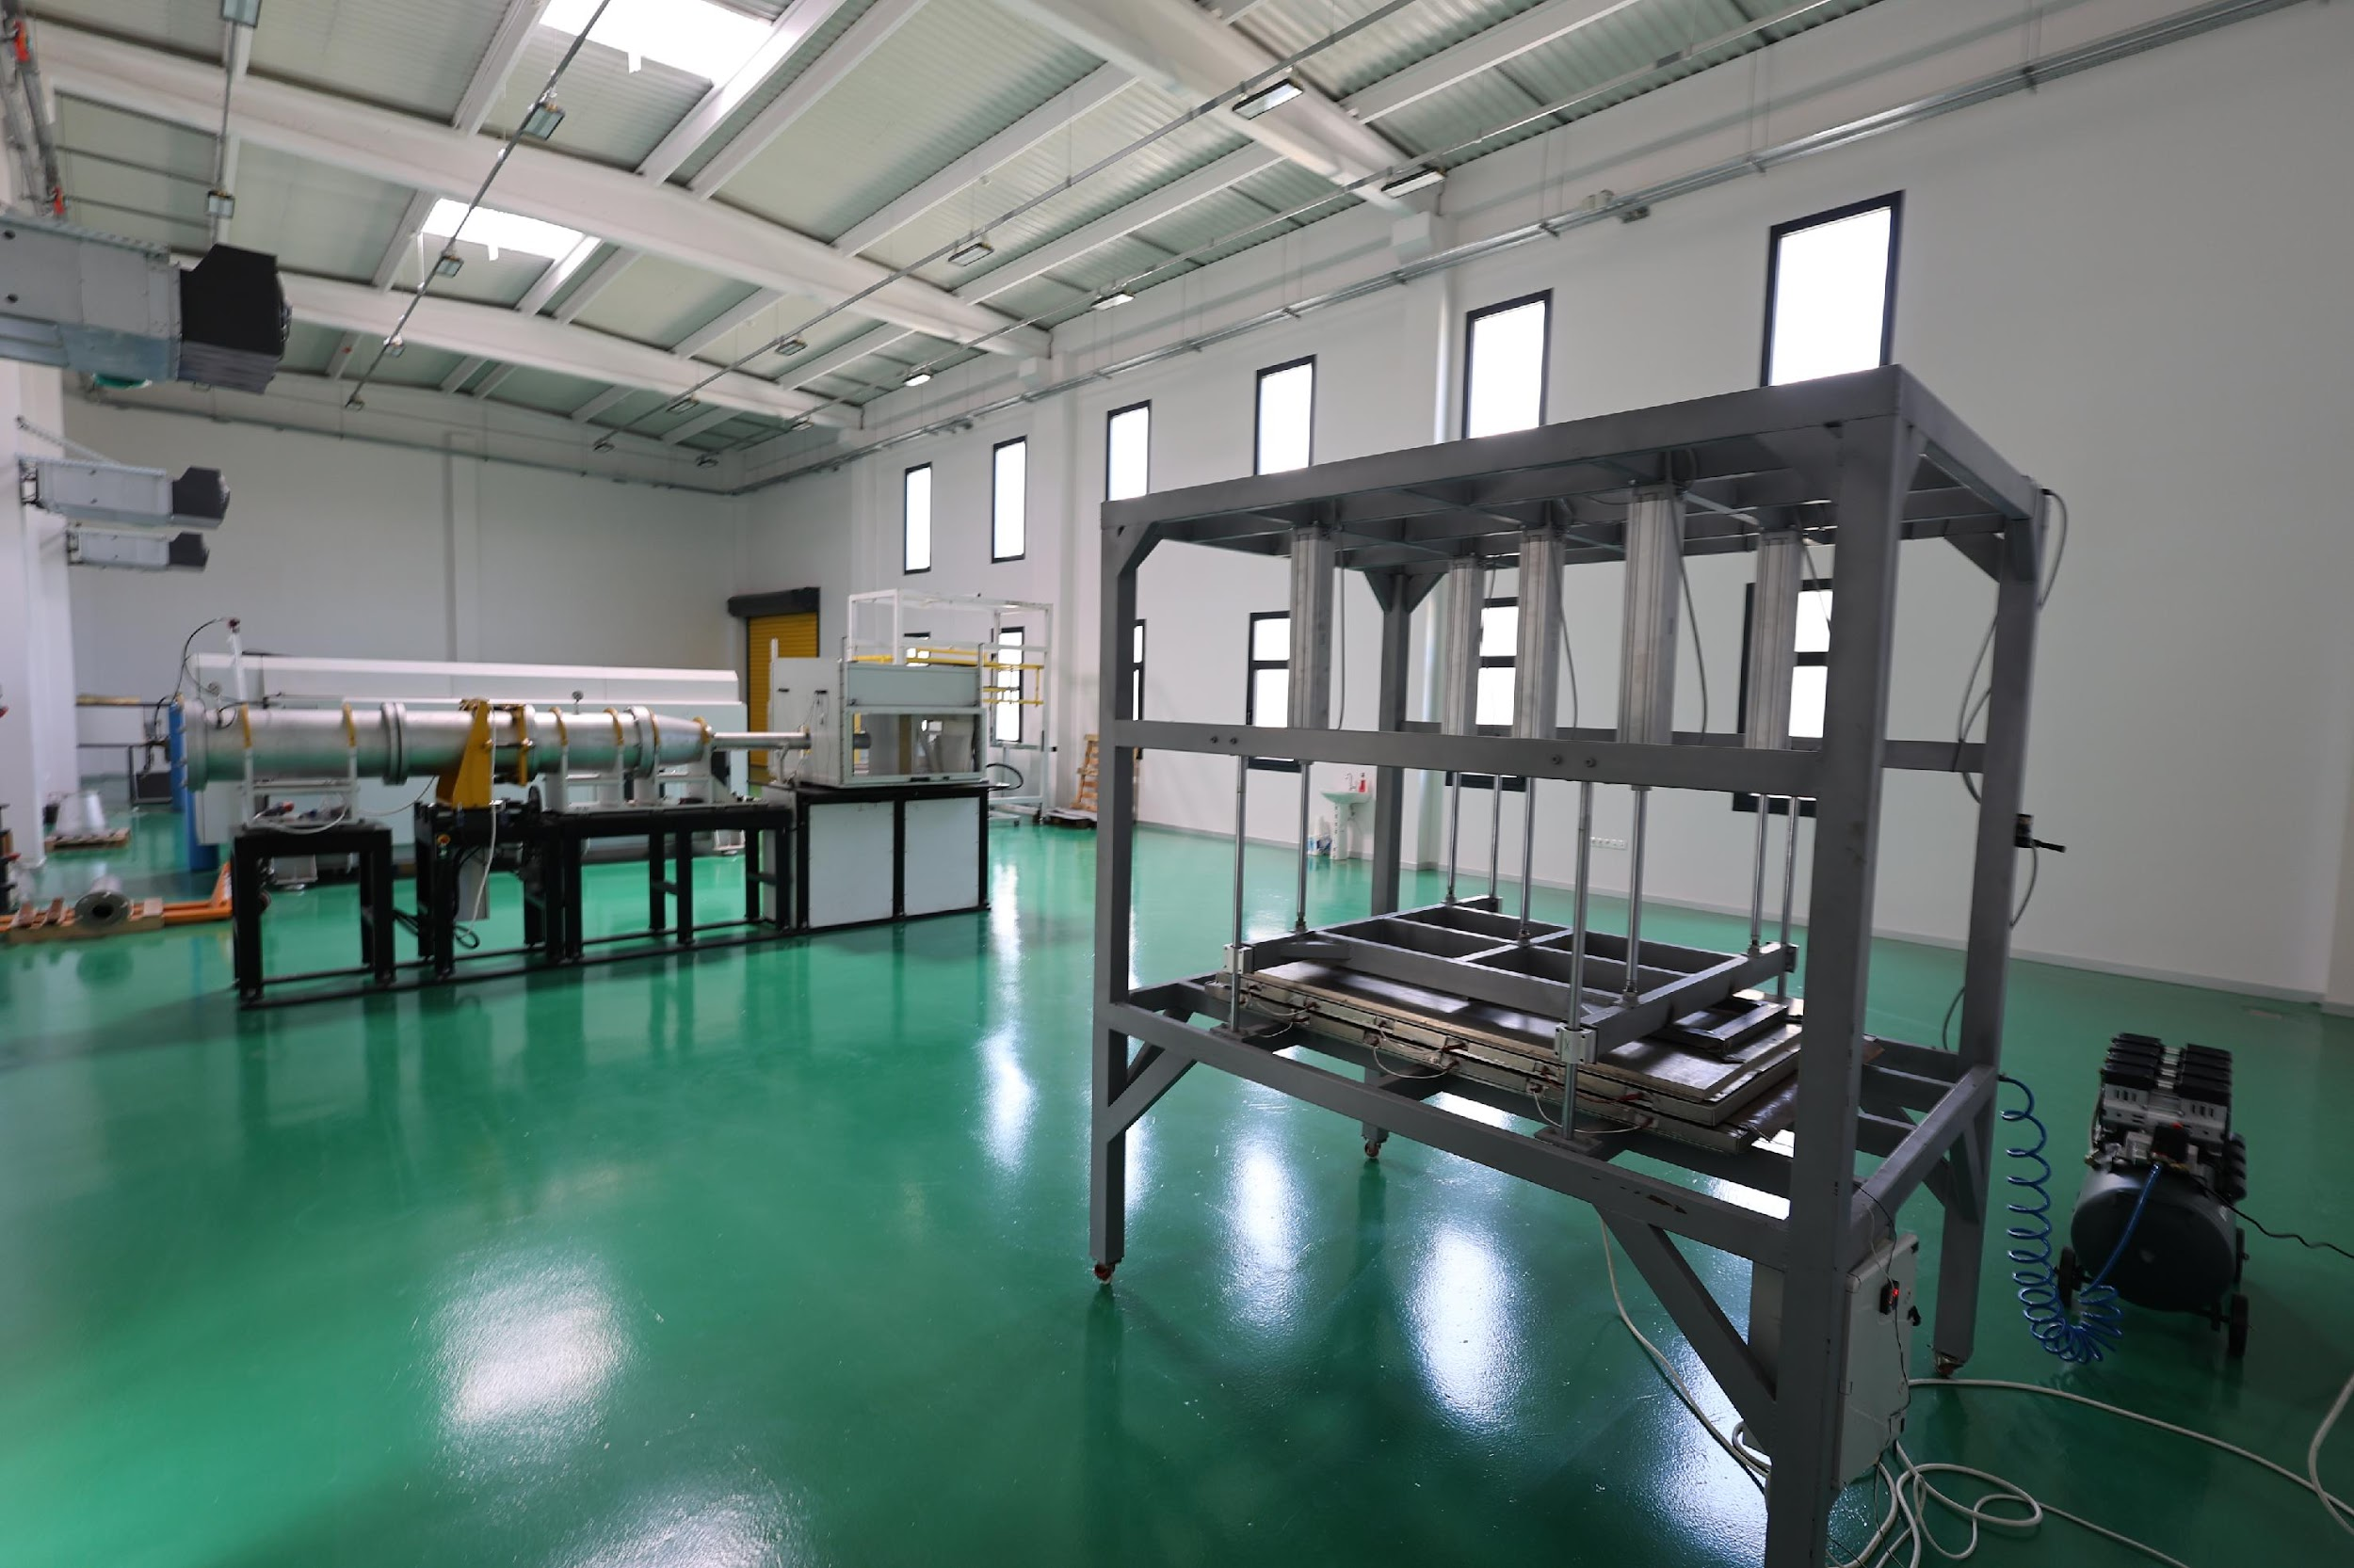
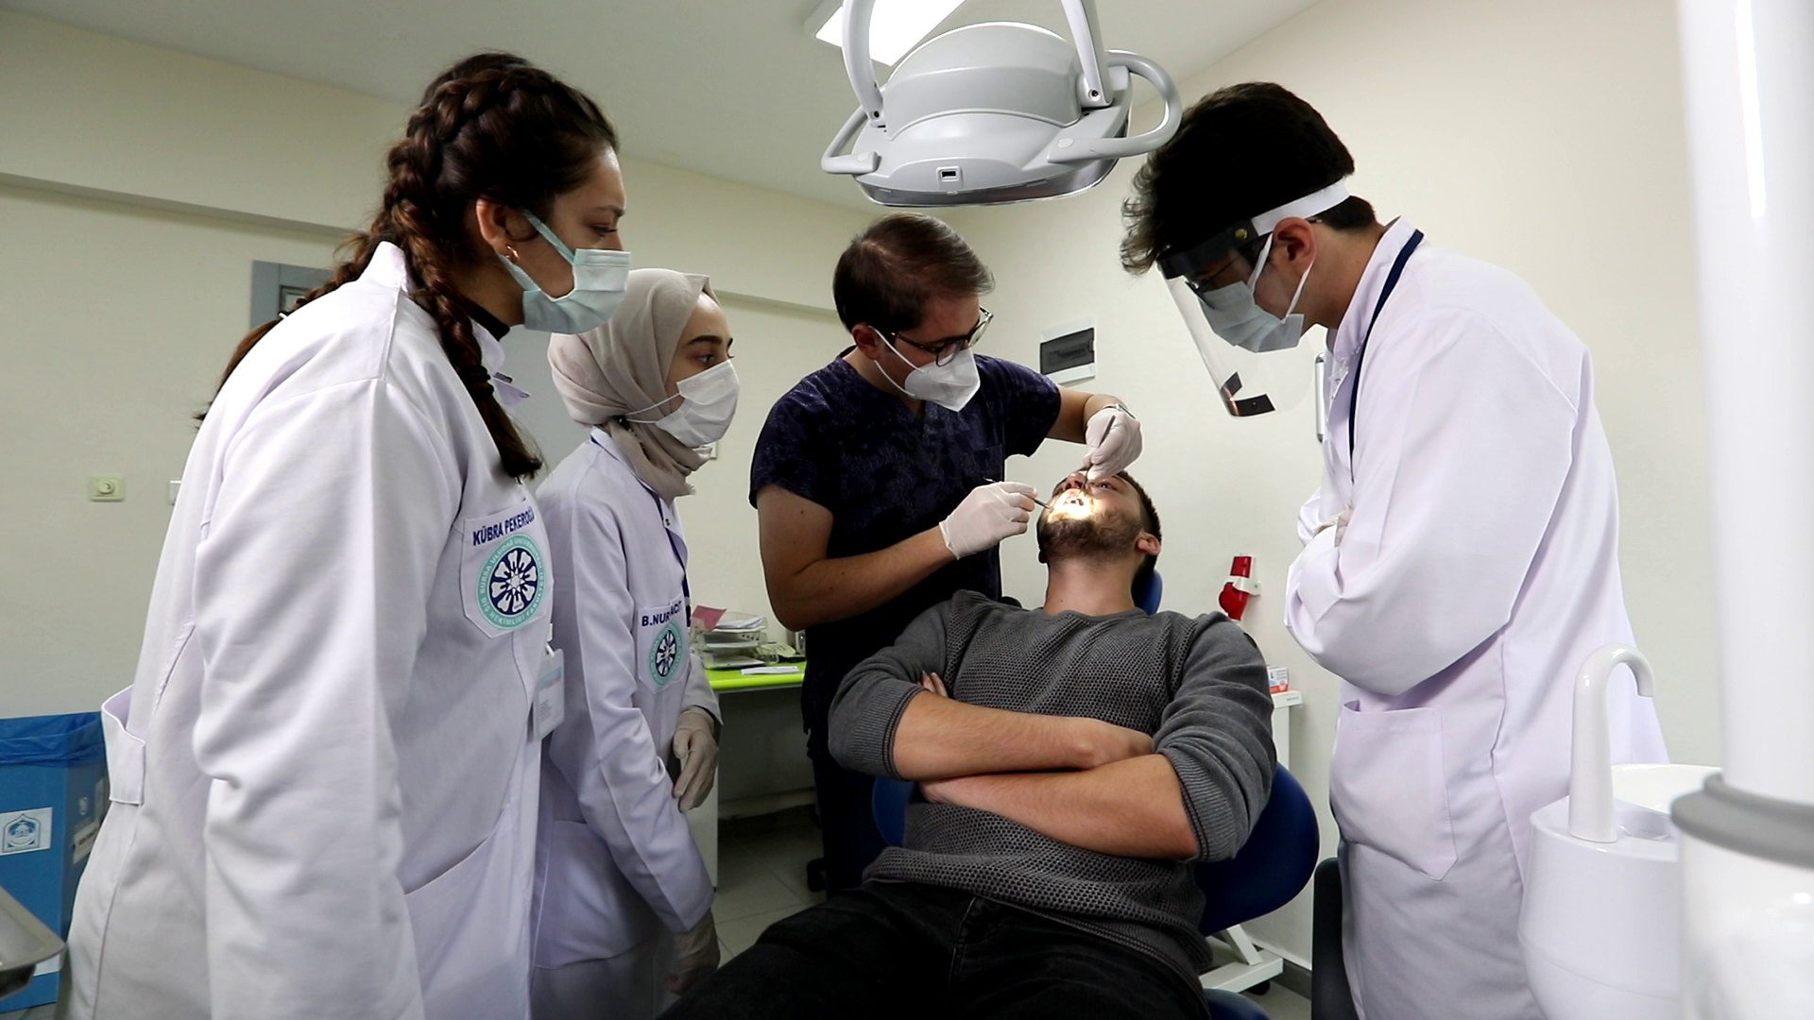
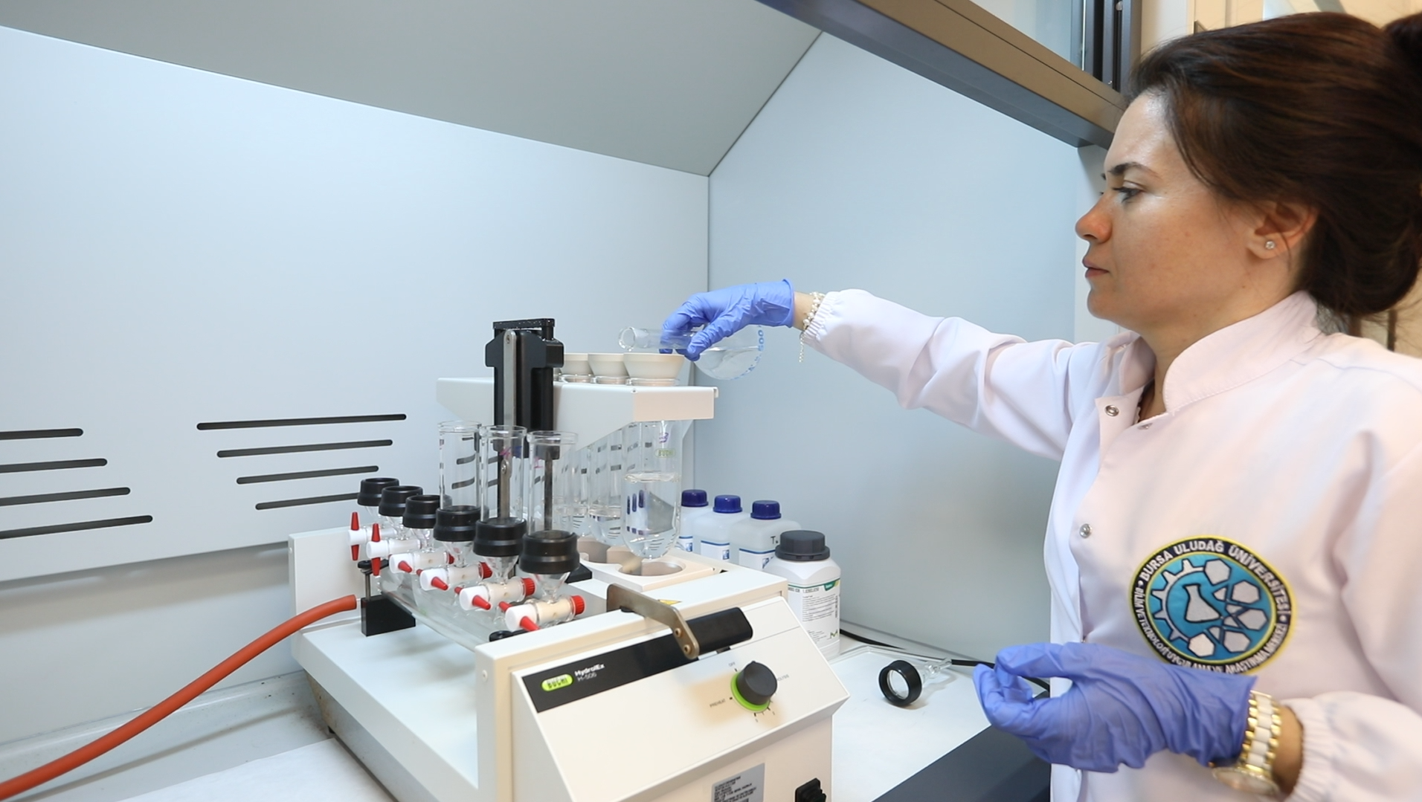
Research and Innovation

Slide 9
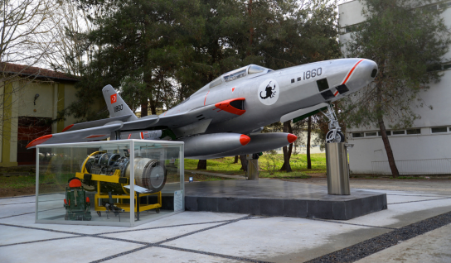
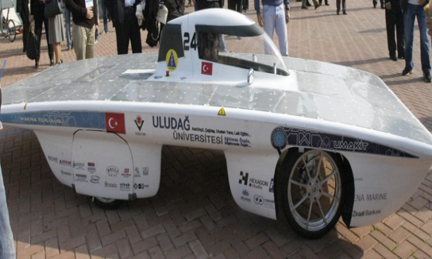
“Research University” Status & Research Figures
RESEARCH INDICATOR | VALUE (ANNUAL)
Research University Status | Since 2021
Scientific Publications | 795
Citations | 45,453
National R&D Projects | 93
National R&D Funding | ₺23,127,212
International Project Funding | ₺479,753
Patent Applications (National and International) | 66
Granted Patents | 14

Slide 10
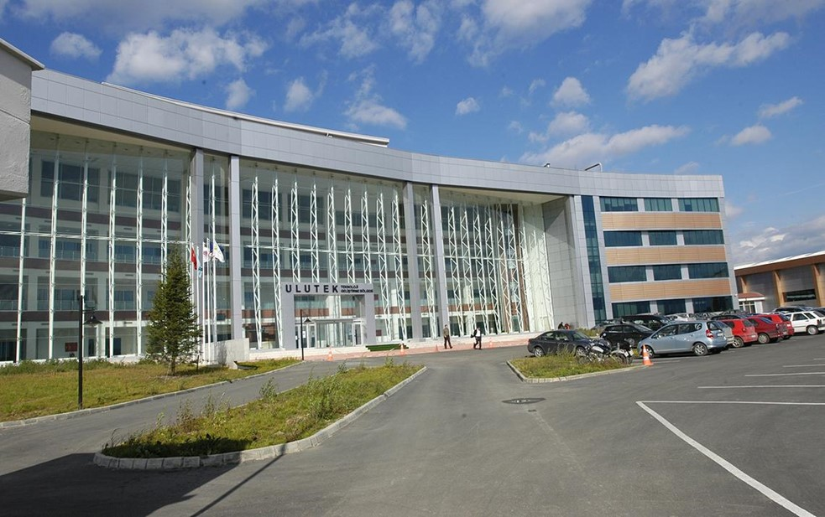
Technopark & Industry Collaboration
Innovation and Entrepreneurship Hub
ULUTEK technopark fosters innovation and entrepreneurship by supporting nearly 200 high-tech companies and startups.
Industry-Academia Collaboration
The technopark facilitates strong cooperation between industry and BUU, enhancing research application.
Advanced Support Infrastructure
ULUTEK provides advanced infrastructure, mentorship, investor networks, and access to university research facilities.
National and International Impact
The technopark promotes national competitiveness and international R&D partnerships for sustainable innovation.

Slide 11
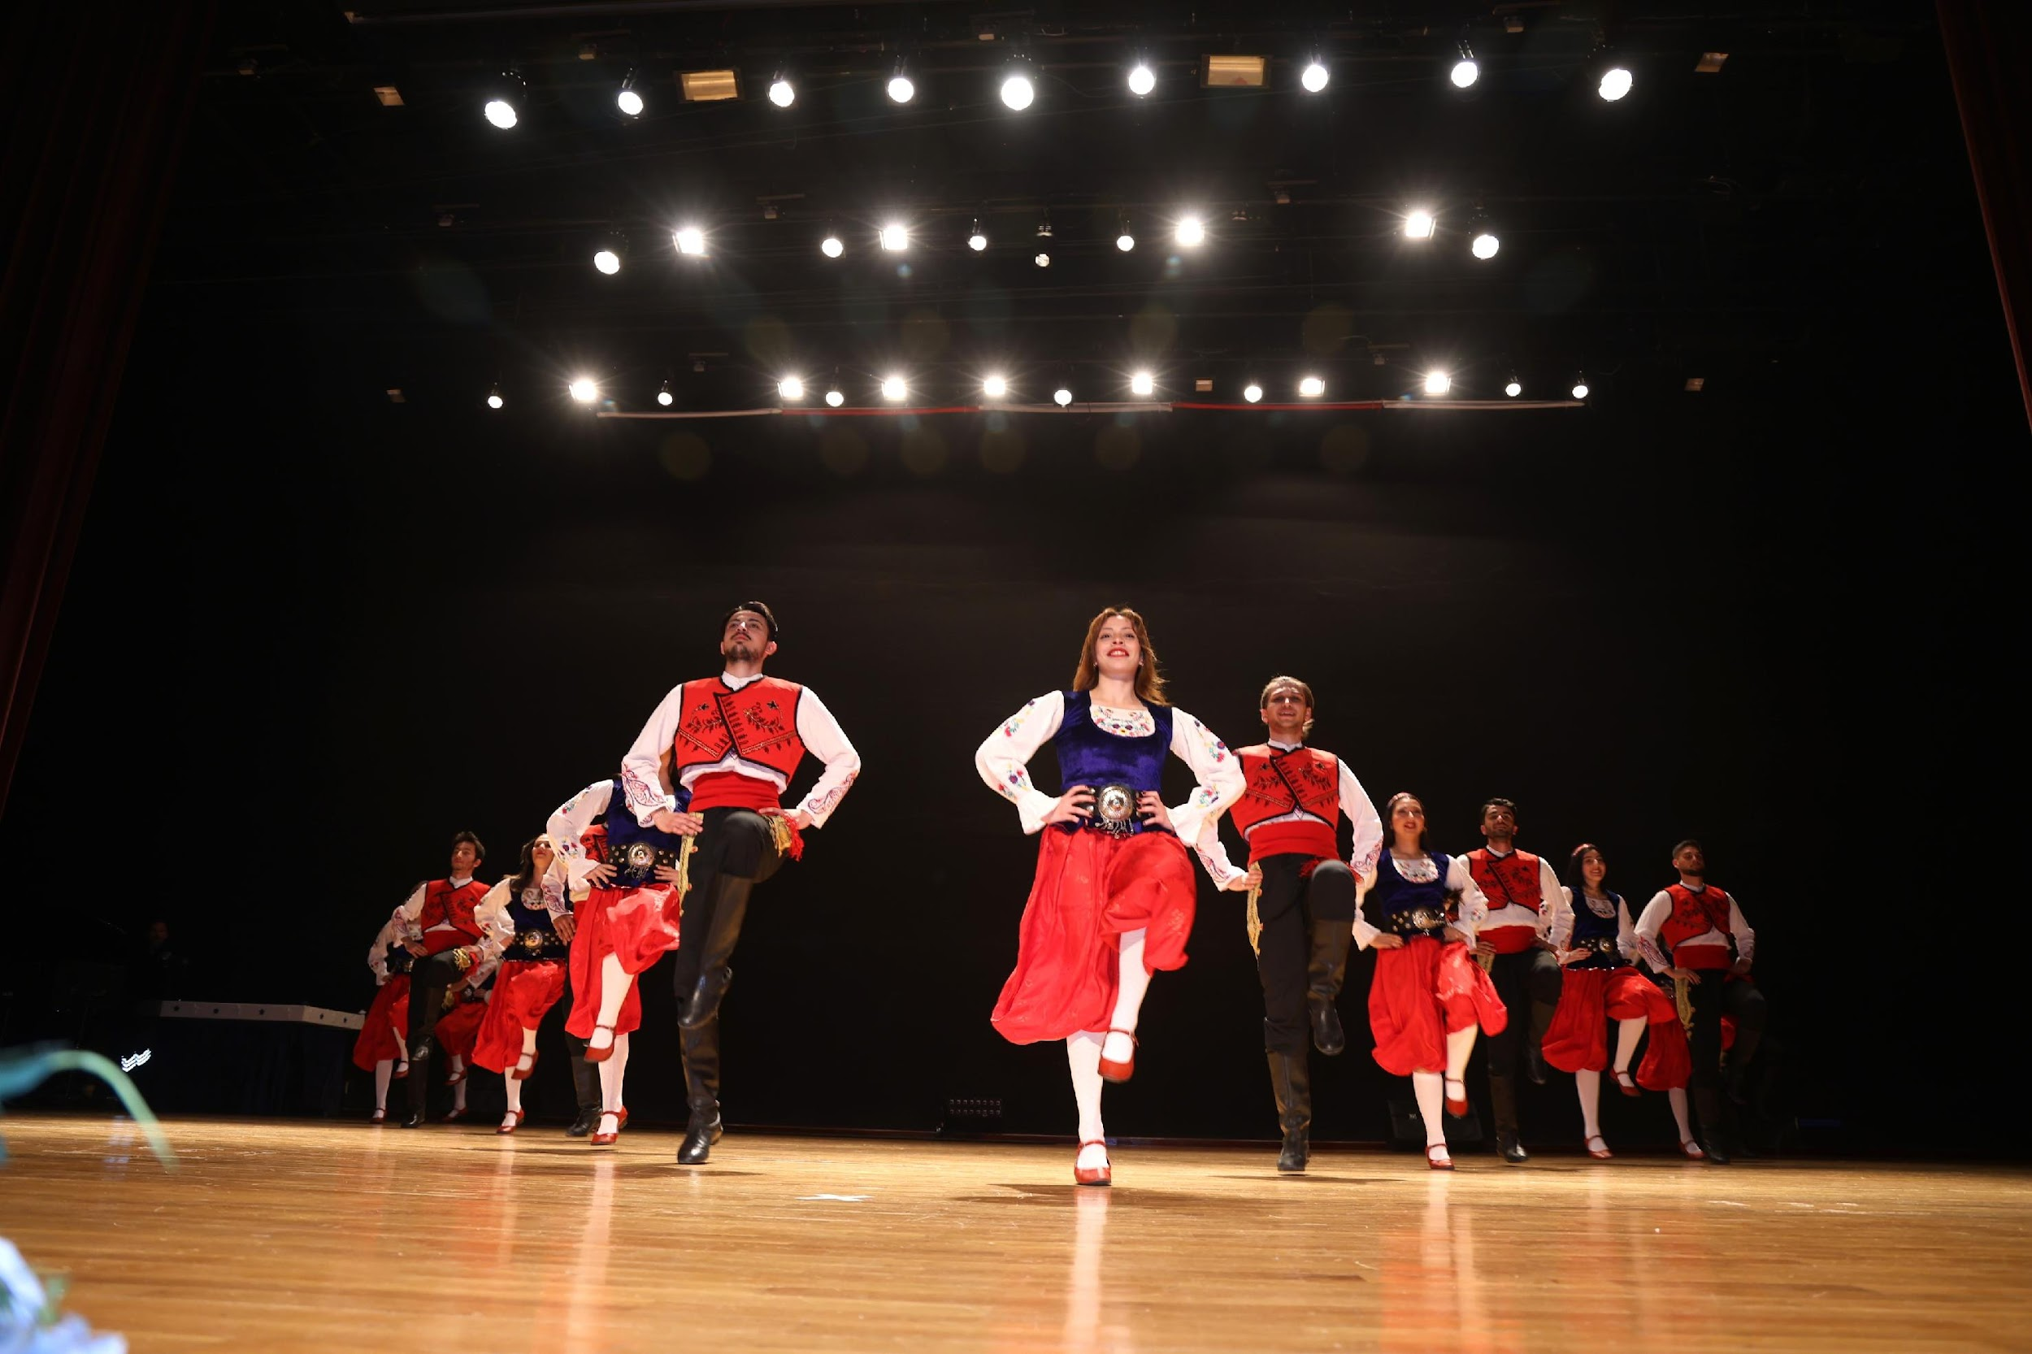
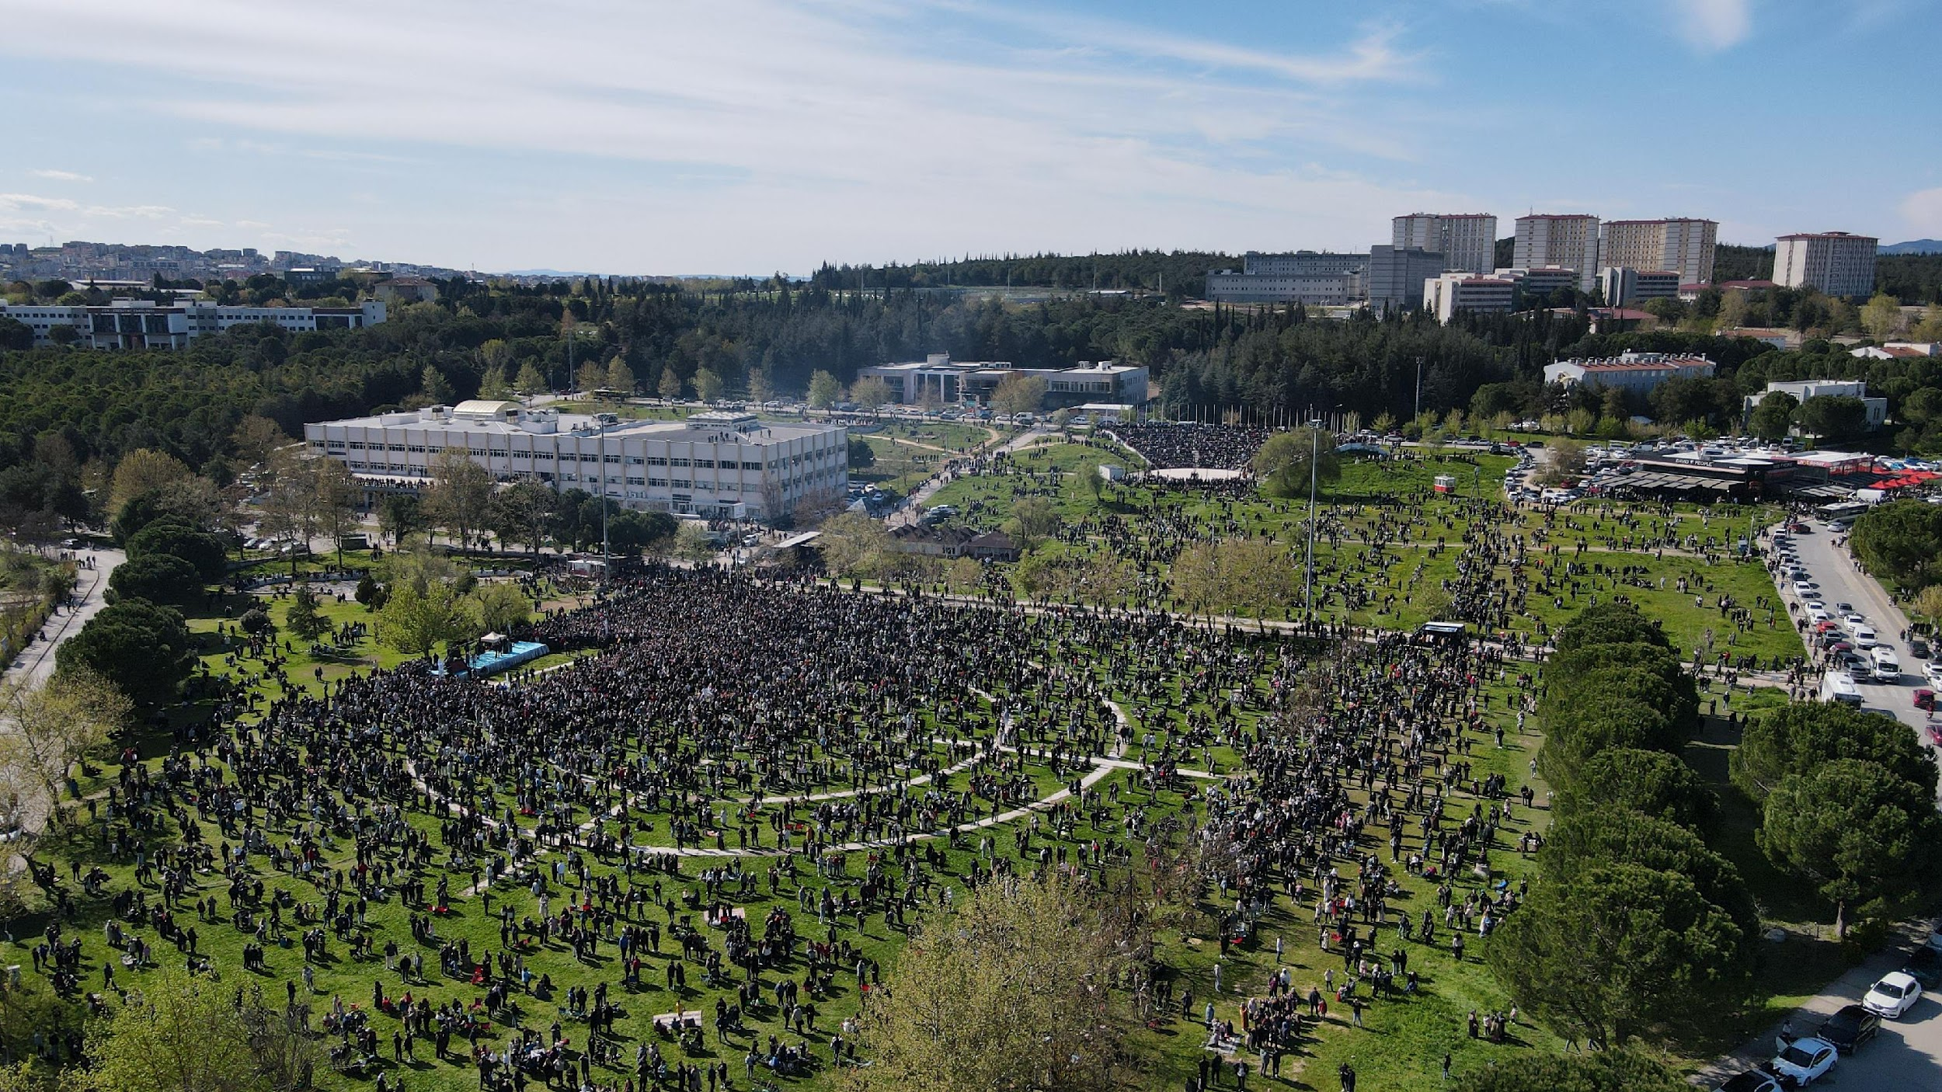
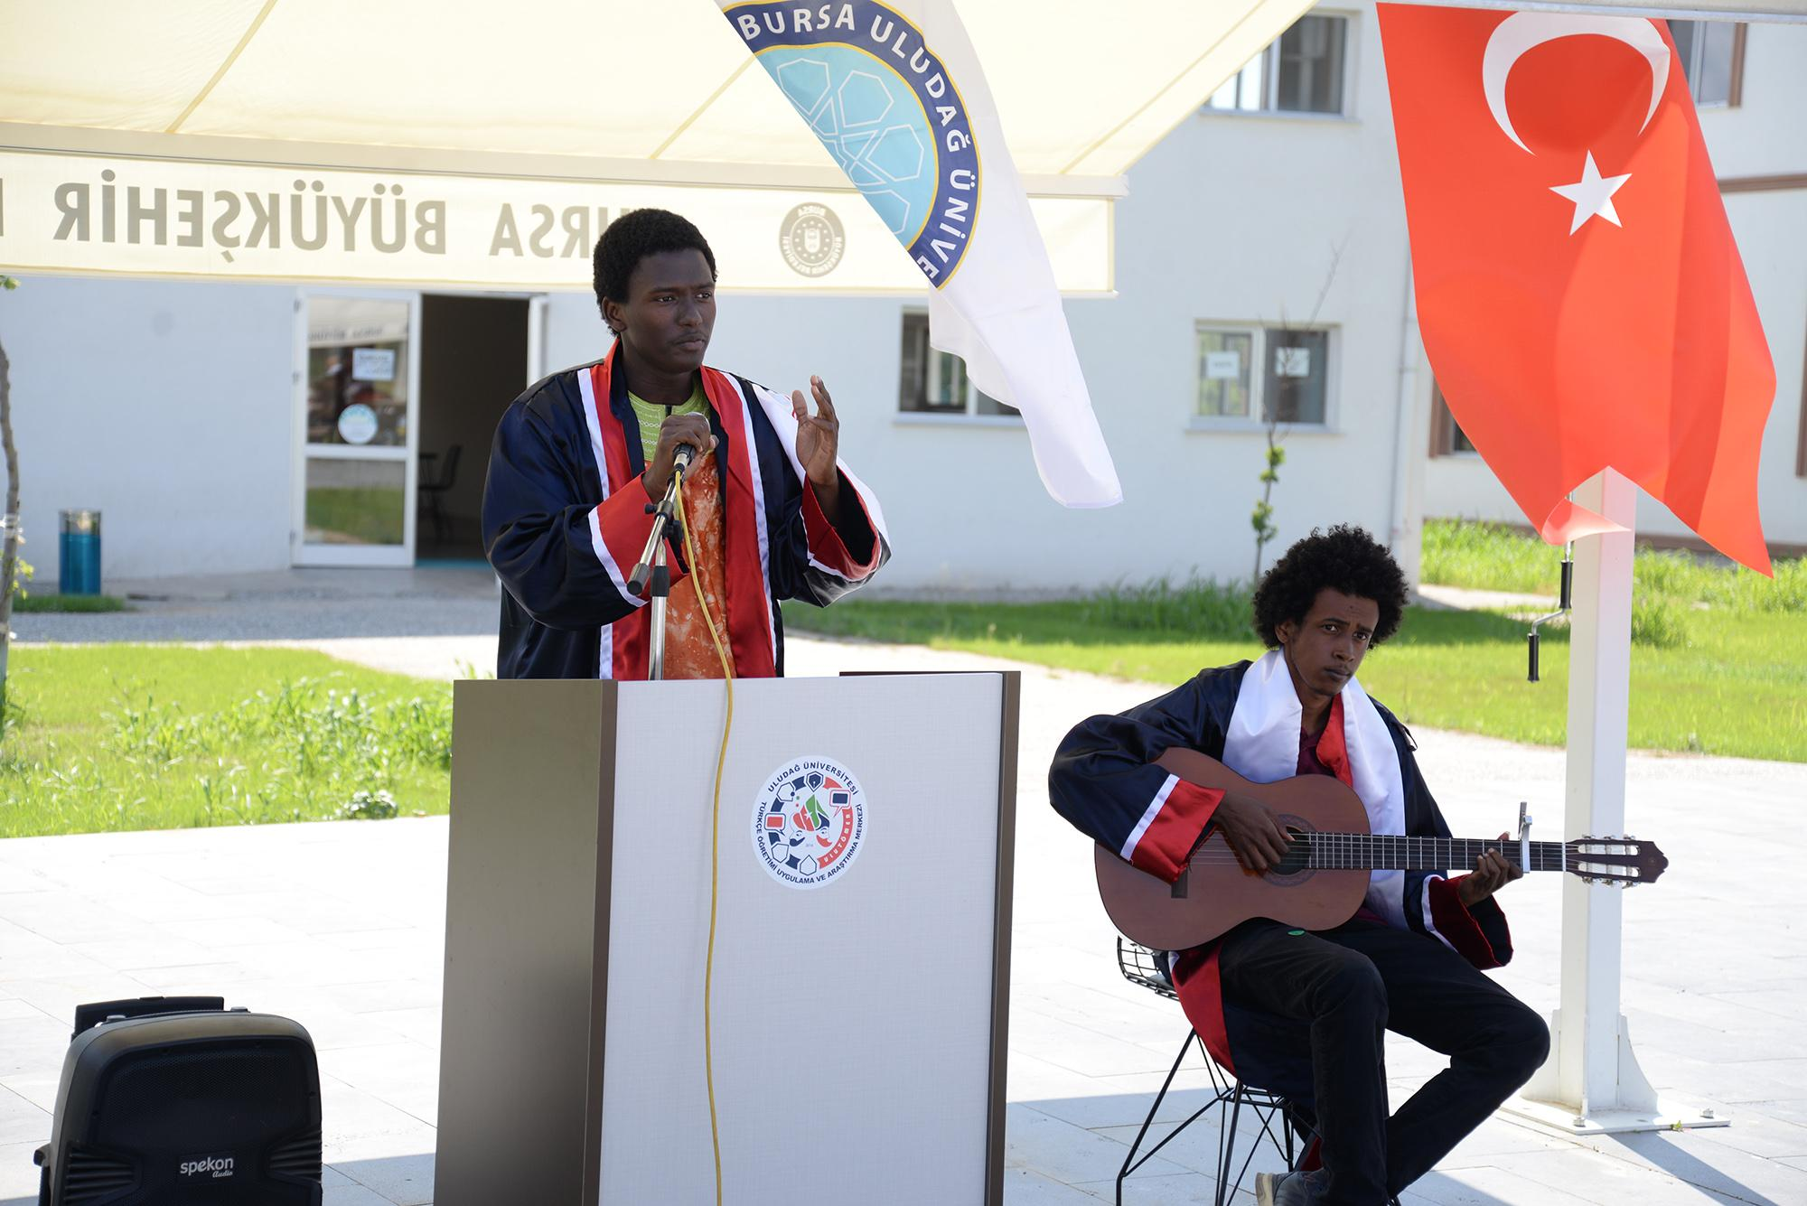
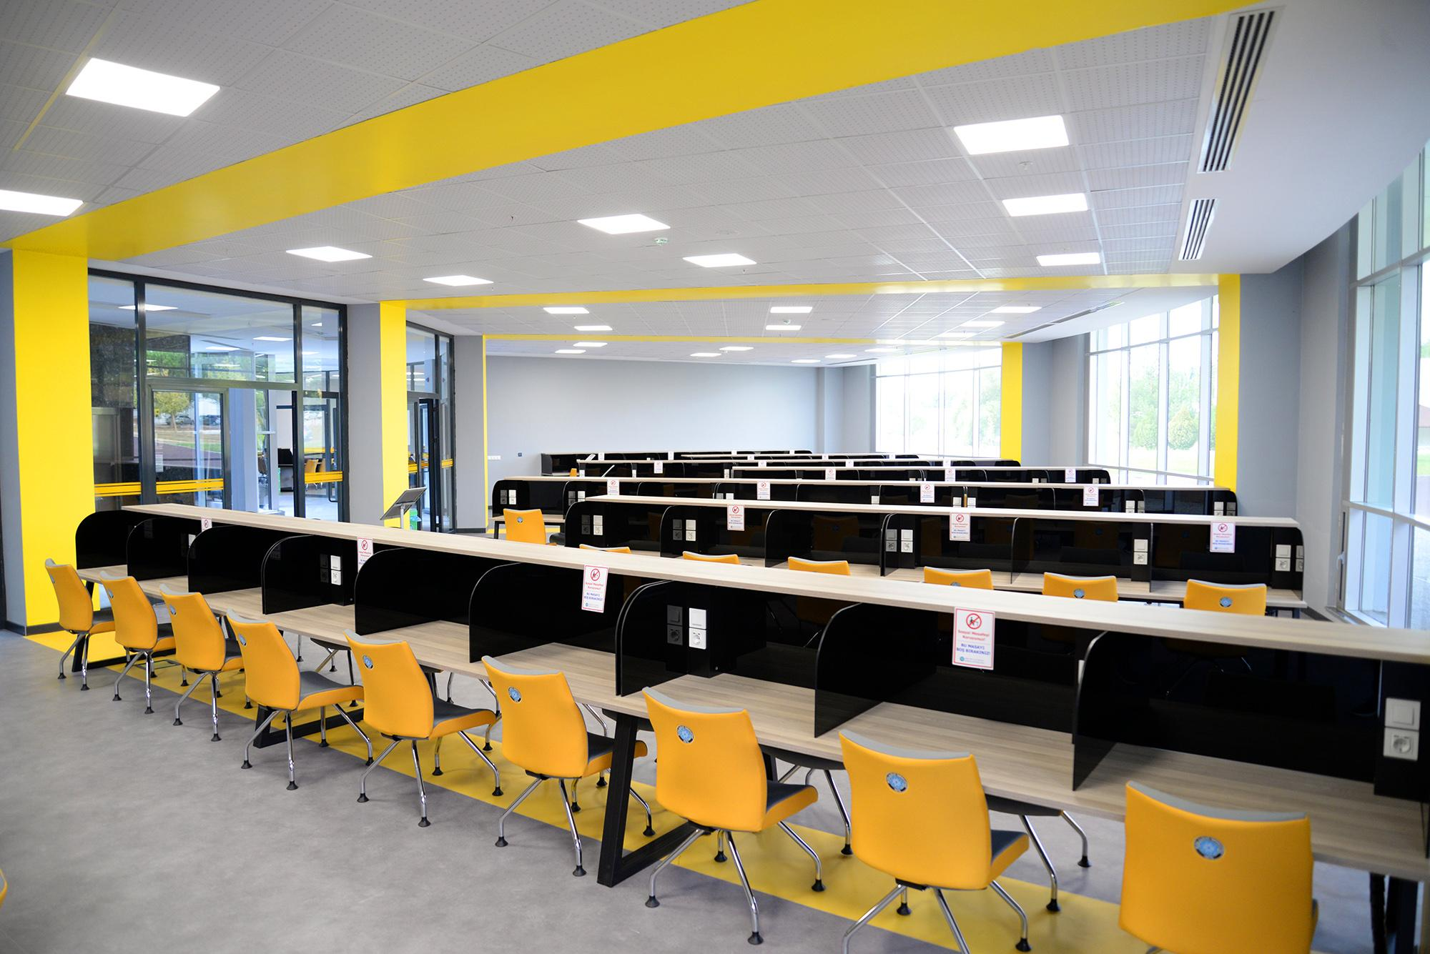
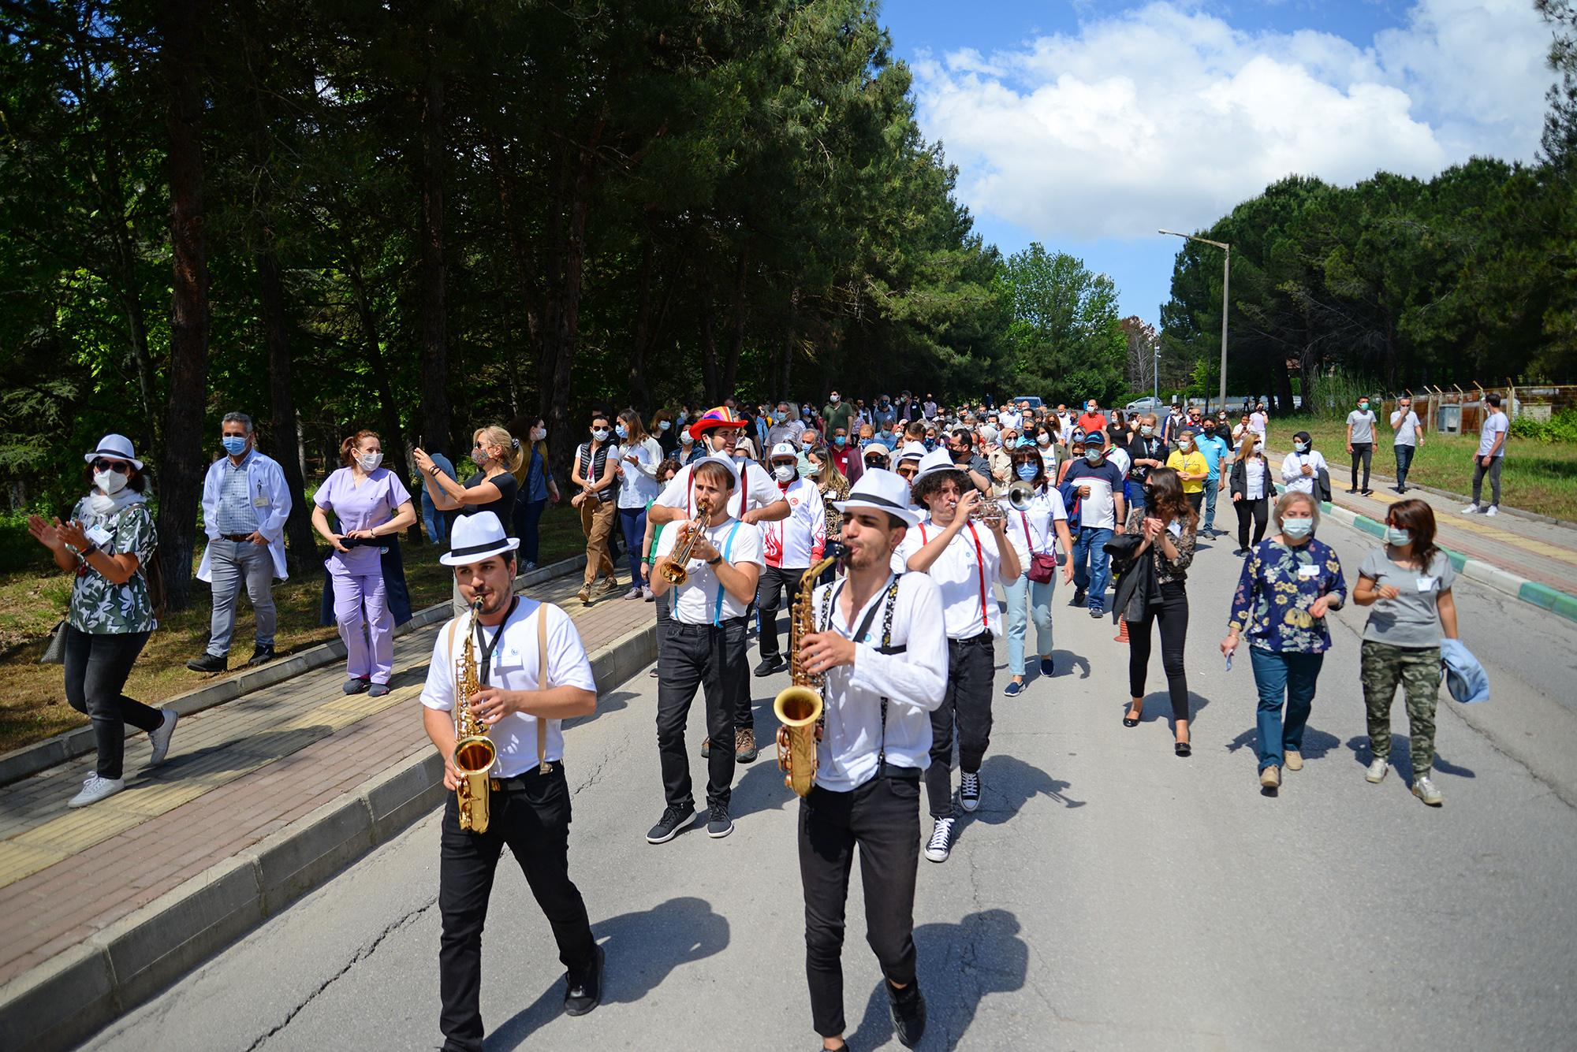
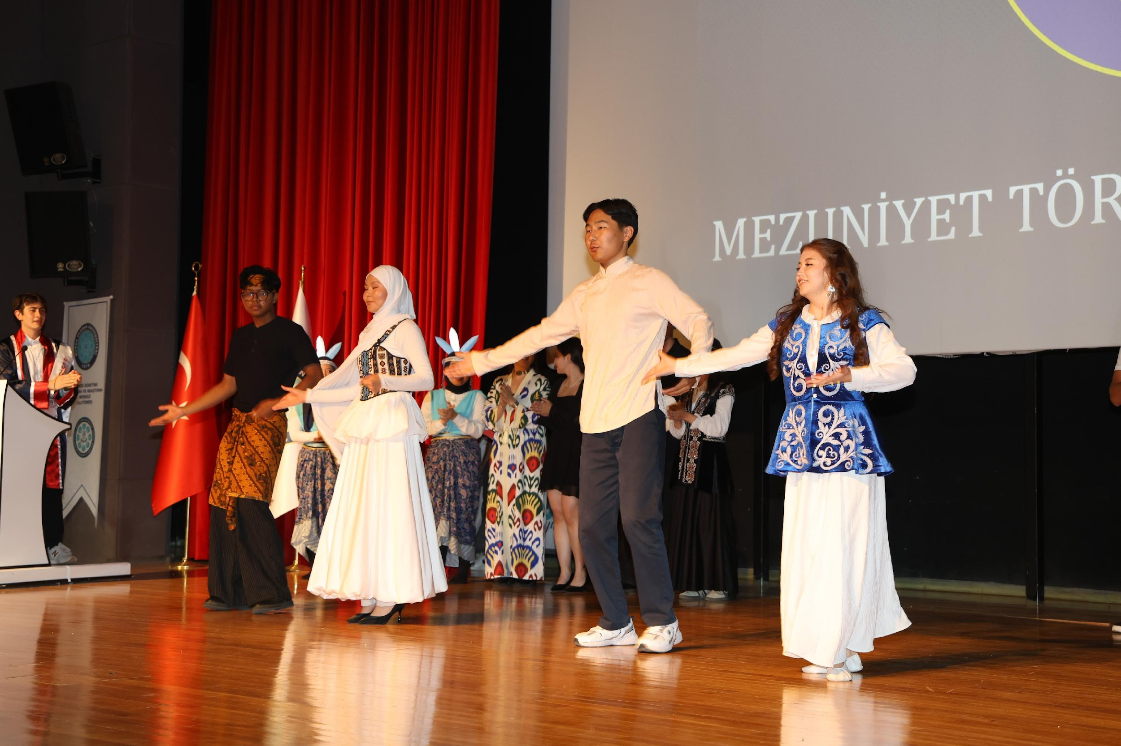
Campus and Student Life

Slide 12
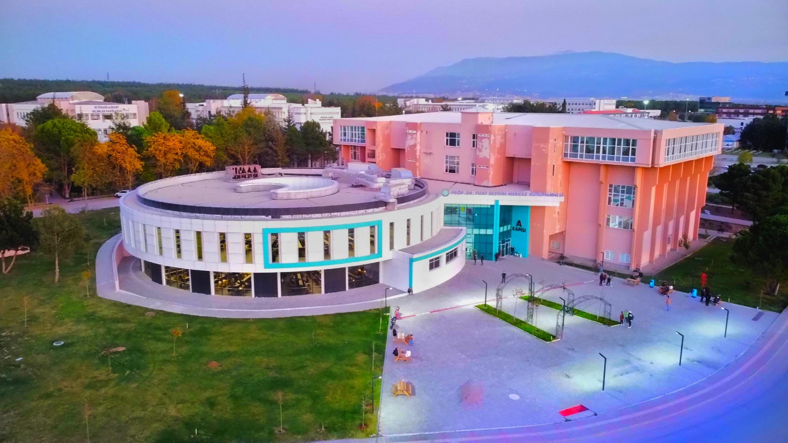
Görükle Campus and Facilities
Nature-Rich Campus Environment
Görükle Campus covers 16,000 decares, with over half forested, creating a peaceful and natural academic setting.
Academic and Social Facilities
The campus offers modern facilities, including student clubs, sports centers, and cultural activities to enrich campus life.
Extensive Library Resources
The Prof. Dr. Fuat Sezgin Central Library houses 200,000 printed books and over 6 million digital resources.
Distributed Specialized Campuses
BUU has specialized campuses across Bursa, expanding academic opportunities in various fields and regions.

Slide 13
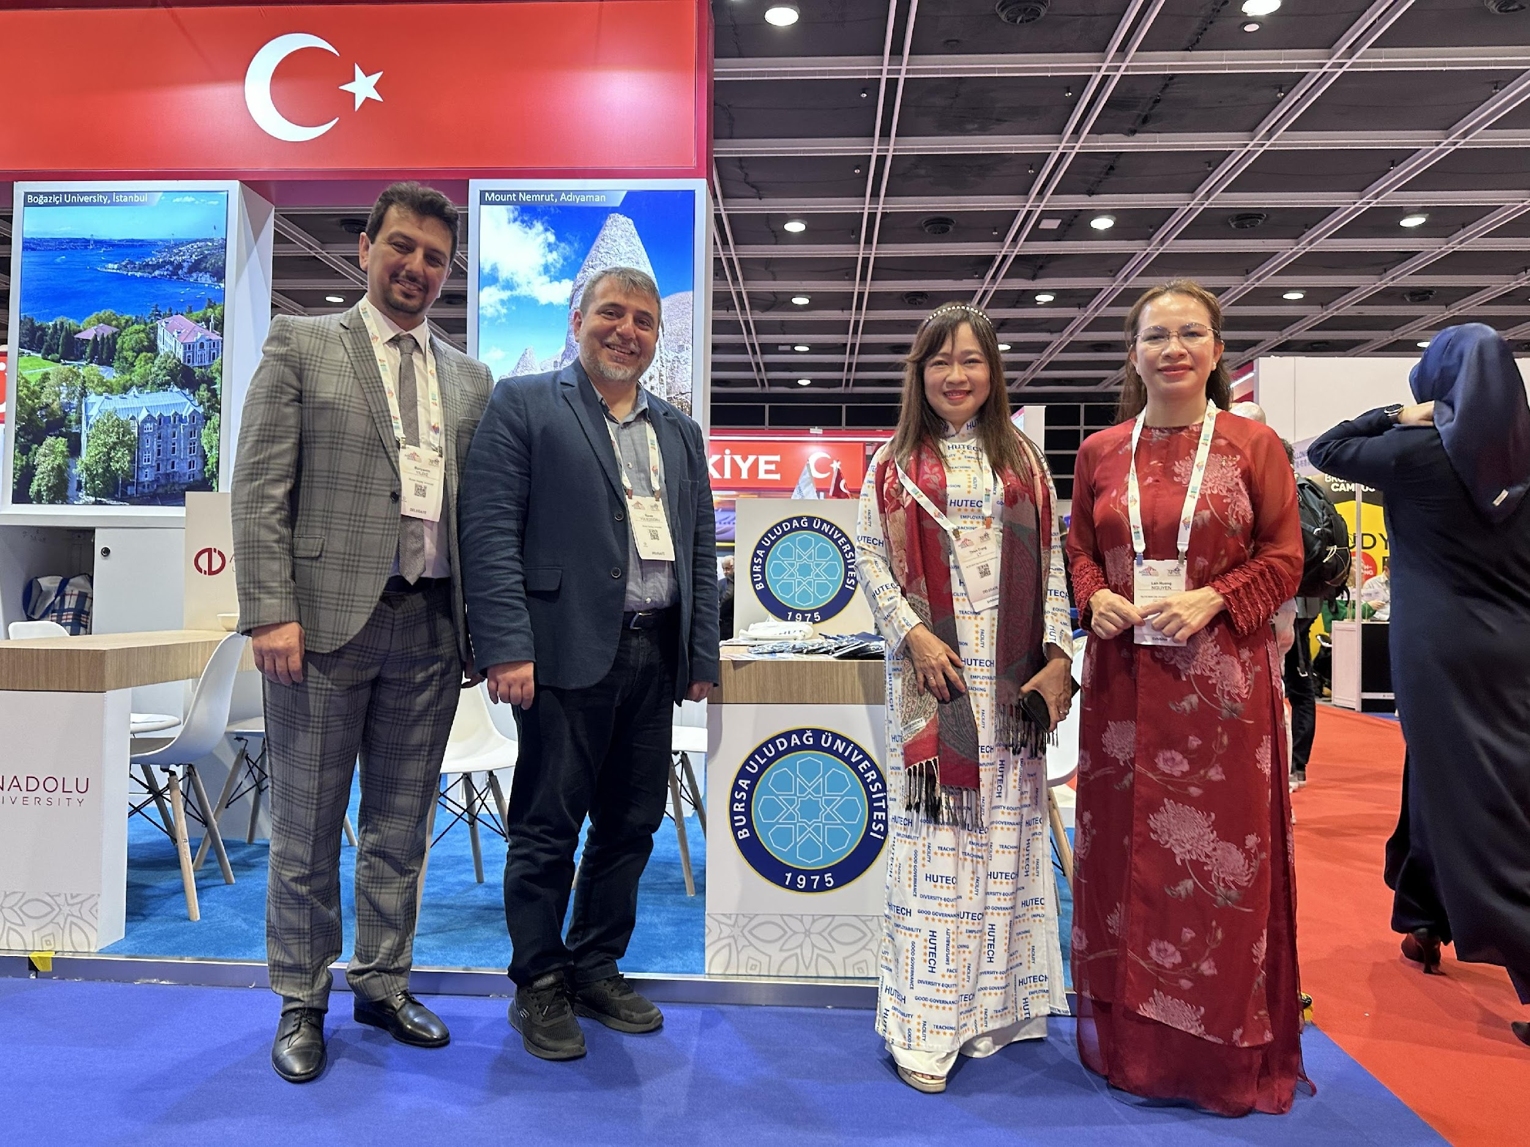
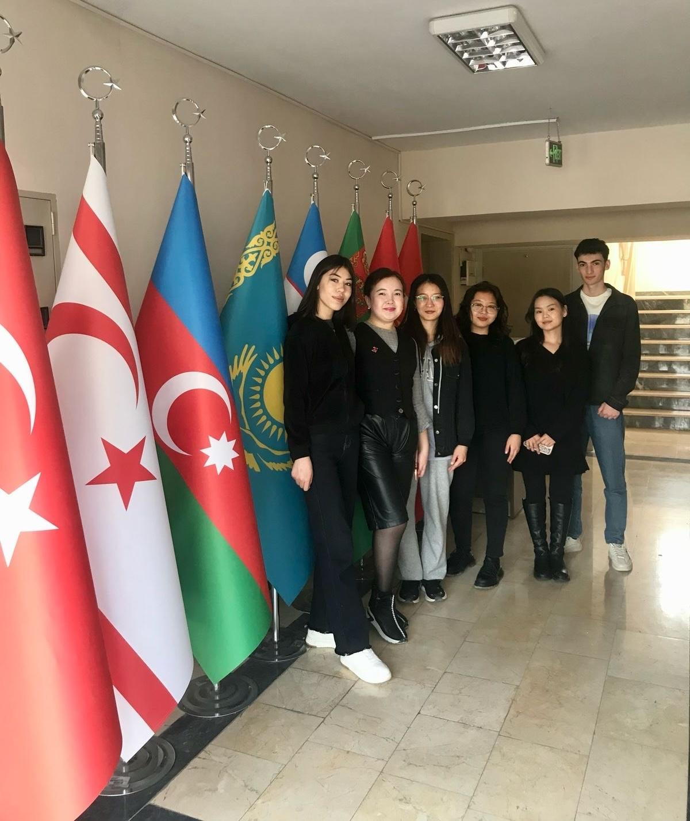
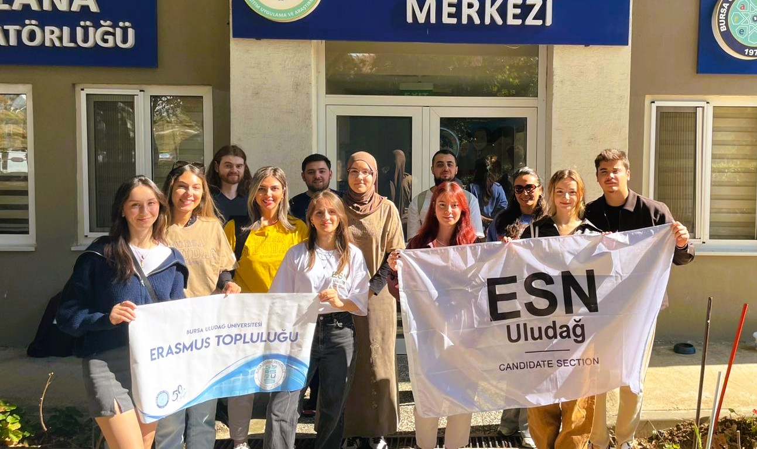
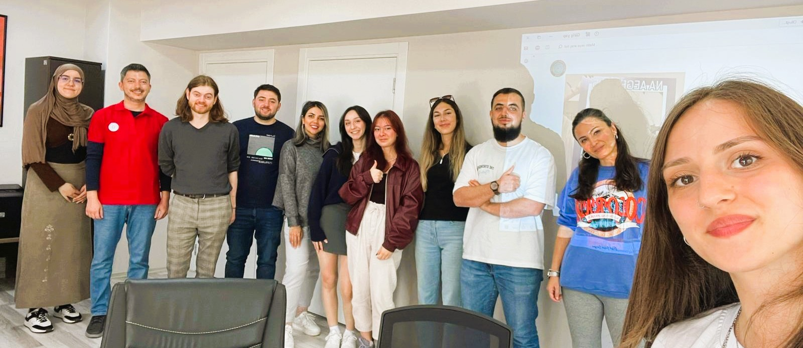
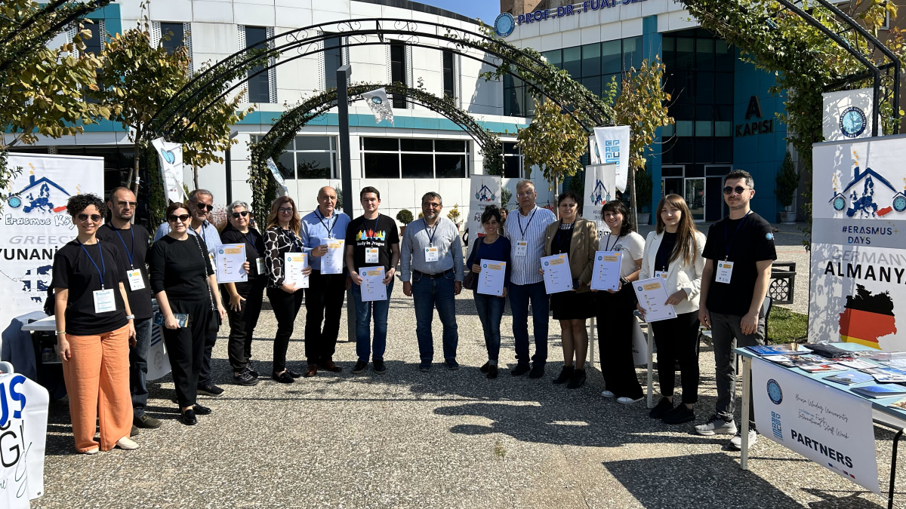
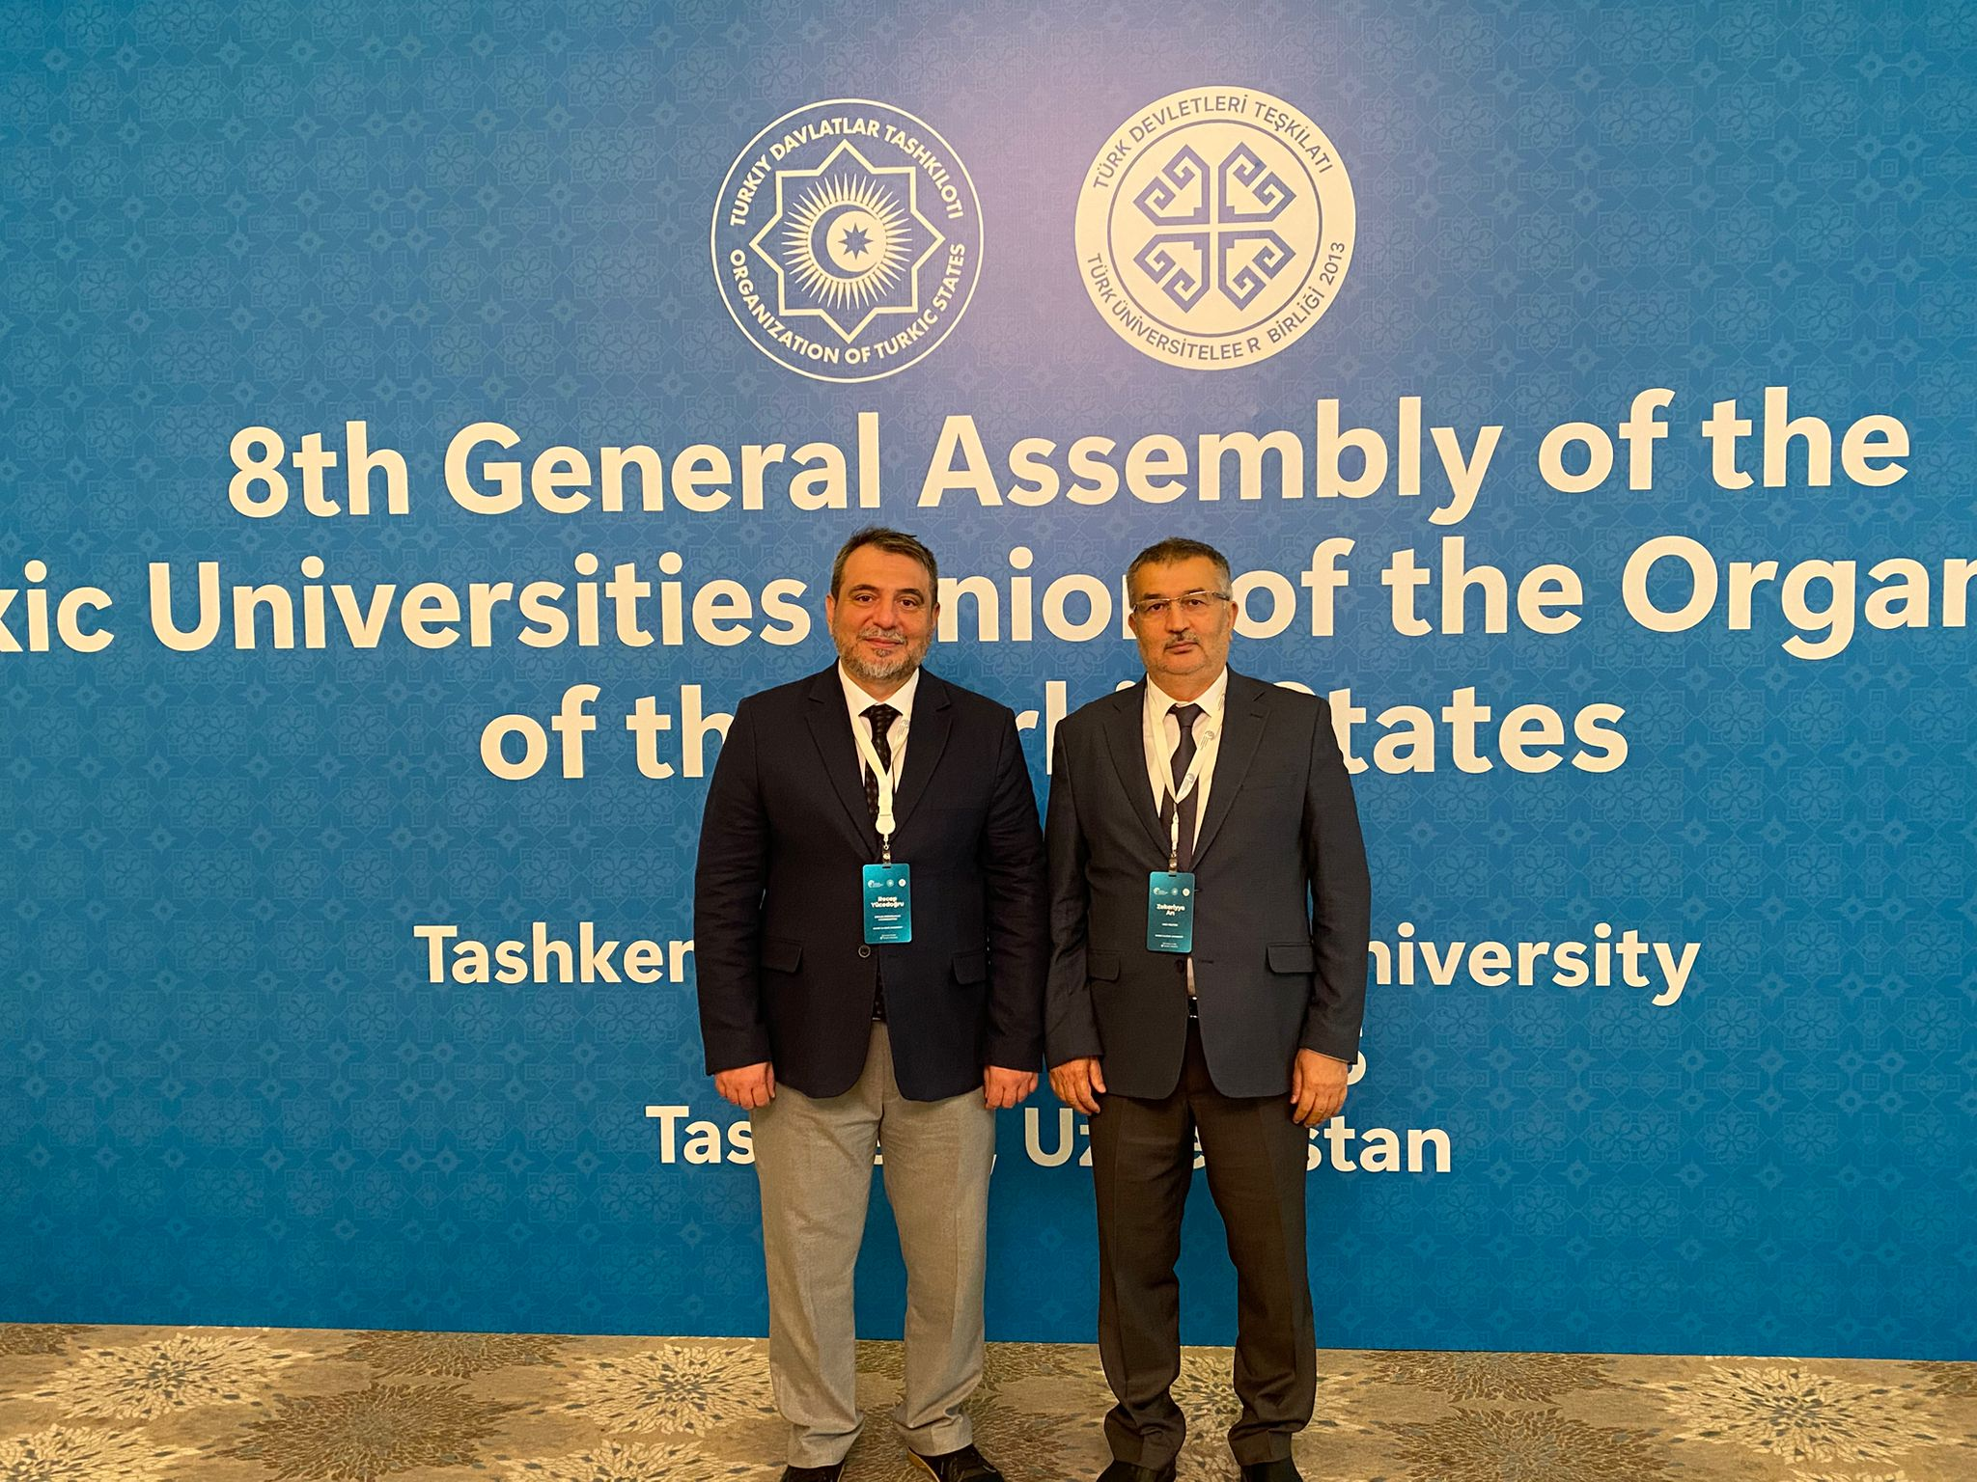
Internationalization

Slide 14
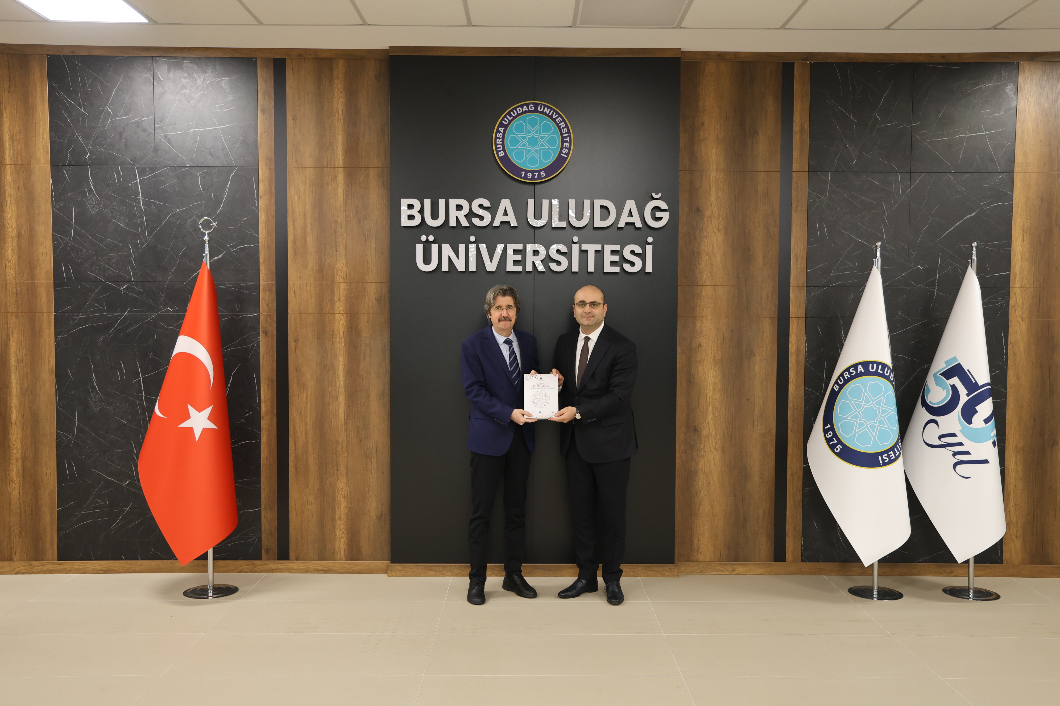
International Collaborations
PROGRAM | SCOPE
Erasmus+ KA131 | EU Mobility (Study, Internship, Training)
Erasmus+ KA171 | Non‑EU Global Mobility
Orhun Exchange Program | Turkic World Universities Exchange
SECONDOS Program | BUU – Innsbruck Bilateral Exchange
JLU Giessen Partnership | Joint Degrees & Research
IAESTE | Paid Technical Internships worldwide

Slide 15
THANK YOU
Contact
MoU & Bilateral Cooperation: uaik@uludag.edu.tr
Erasmus+ Partnership: erasmus@uludag.edu.tr
Orhun Exchange Program: orhun@uludag.edu.tr

